Slide 1
The EntreComp Framework for Intangible Heritage IHF asbl

Slide 2
OBJECTIVES AND GOALS
At the end of this module you will be able to:
Improve your command of EntreComp Framework
The Entrepreneurial Competence Framework represents the most robust and reliable model for education and training on entrepreneurial capacities
Develop new ideas for opportunities in ICH
This training module focuses on the first pillar of EntreComp’s training areas: IDEAS & OPPORTUNITIES. Readers can find new interesting sources of inspiration to valorize their ICH business
Acquire ICH-innovative competences
In the last section of this training module, readers will be introduced to practical knowledge that they can experiment with to boost their awareness of creative resources for ICH
The European Commission's support for the production of this publication does not constitute an endorsement of the contents, which reflect the views only of the authors, and the Commission cannot be held responsible for any use which may be made of the information contained therein.

Slide 3
INDEX
Unit 3
Unit 2
The IDEA & OPPORTUNITIES’ pillar: detailed breakdown
Unit 1
Guide to EntreComp: structure & content
Policy background and introduction to EntreComp

Slide 4
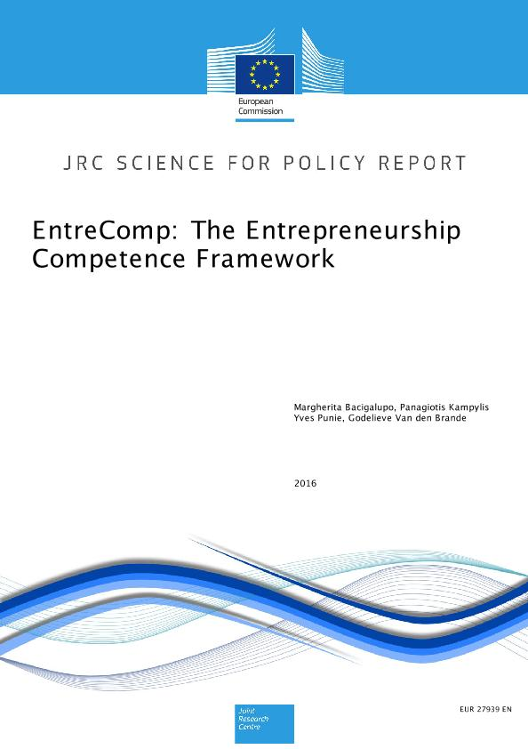
Unit 1
Section 1 – The Entrepreneurial Competence Framework
Back in 2016, the Joint Research Centre of the European Commission published the official European Framework for Entrepreneurial Competences.
The framework has been developed in close collaboration with DG for Employment, Social Affairs and Inclusion, and as of today, it represents the largest effort at international level to propose a “commonly-shared” definition of Entrepreneurship as a competence.
The European Commission's support for the production of this publication does not constitute an endorsement of the contents, which reflect the views only of the authors, and the Commission cannot be held responsible for any use which may be made of the information contained therein.

Slide 5
Unit 1
Section 1 – Entrepreneurship as a competence
The fact that Entrepreneurship is framed as a “competence”, rather than as a “profession” has some very particular implication on the concrete application and valorization of the framework at EU level.
The framework has designed in fact, can be of great use not only for start-uppers and aspiring entrepreneurs, but also for average citizens since the EntreComp tackles LLL (longlife learning) opportunities intended in a much broader sense, starting from sense of initiative, self-reliability, ethical thinking, and much more.
In that sense, the EntreComp widens its impact’s radius way beyond business, economics, and entrepreneurship, generating concrete social outcomes even from the side of active citizenship, inclusion, and employability.
The European Commission's support for the production of this publication does not constitute an endorsement of the contents, which reflect the views only of the authors, and the Commission cannot be held responsible for any use which may be made of the information contained therein.

Slide 6
Unit 1
Section 2 – The policy background of the EntreComp
The first EntreComp seed dates way back before 2016.
At the end of 2006, the Official Journal of the European Union published a key recommendation from the European Parliament and Council of Europe intended for all Member States, with specific focus on the provision of key competences for all as part of their lifelong learning strategies.
National strategies should align to a “Key Competences for Lifelong Learning Framework” as initially described by the policy paper itself.
The European Commission's support for the production of this publication does not constitute an endorsement of the contents, which reflect the views only of the authors, and the Commission cannot be held responsible for any use which may be made of the information contained therein.

Slide 7
Unit 1
Section 2 – The policy background of the EntreComp: Key Competences for Lifelong Learning Framework
The Key Competences for Lifelong Learning Framework tackled essentially four main areas of interest:
Identification and valorisation of competences/skills for people’s empowerment (i.e., employability, social inclusion, active citizenship) in knoweledge driven economies and societies.
Sustain Member States in assuring the effectiveness and impact of national education curricula while facilitating the transtion of young people into the labour market, and fosterning further training opportunities for seniors and adults for re-qualification, upskilling, professional development, and social inclusion.
Provide a European level reference model for national stakeholders, professionals in the domain of education, and final targets to spread a common ground of reference that is recognizable regardless the geographical context of application.
Work towards the 2010’s Education and Training Programmes and provide a framework for further correlated actions.
The European Commission's support for the production of this publication does not constitute an endorsement of the contents, which reflect the views only of the authors, and the Commission cannot be held responsible for any use which may be made of the information contained therein.

Slide 8
Unit 1
Section 2 – The policy background of the EntreComp: Sense of Initiative and Entrepreneurship
Based on the aforementioned objectives, Parliament and Council propose eight key competences to which the LLL framework applies to:
Communication in the mother tongue
Communication in foreign languages
Mathematical competence and basic competences in science and technology
Digital competence
Learning to learn
Social and civic competences
Sense of initiative and entrepreneurship
Cultural awareness and expression
The European Commission's support for the production of this publication does not constitute an endorsement of the contents, which reflect the views only of the authors, and the Commission cannot be held responsible for any use which may be made of the information contained therein.

Slide 9
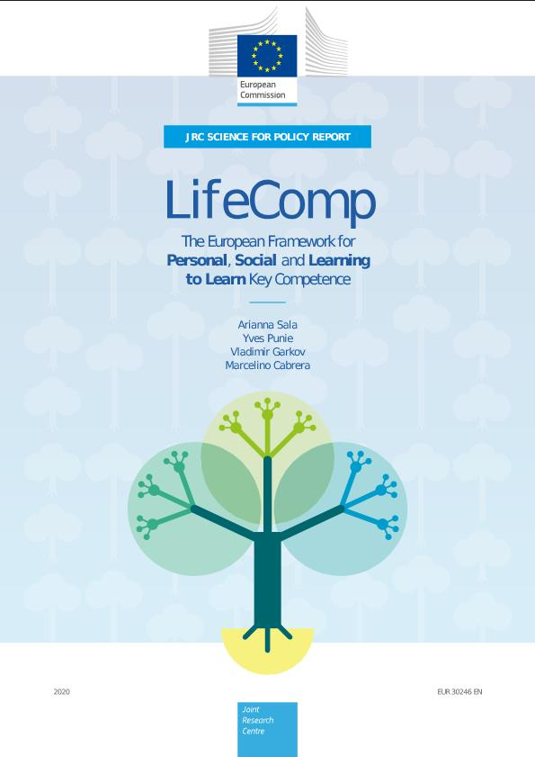
Unit 1
Section 3 – Today’s EU Frameworks for education and training
Based on the third key area of interest of the LLL framework (i.e., provision of a European level reference model), as of today, we do have two other main frameworks for education, training and longlife learning:
The European Commission's support for the production of this publication does not constitute an endorsement of the contents, which reflect the views only of the authors, and the Commission cannot be held responsible for any use which may be made of the information contained therein.

Slide 10
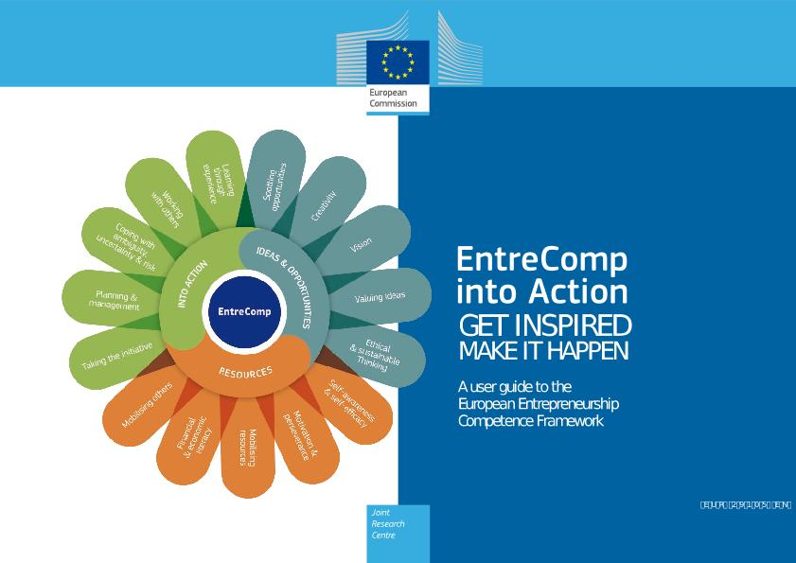
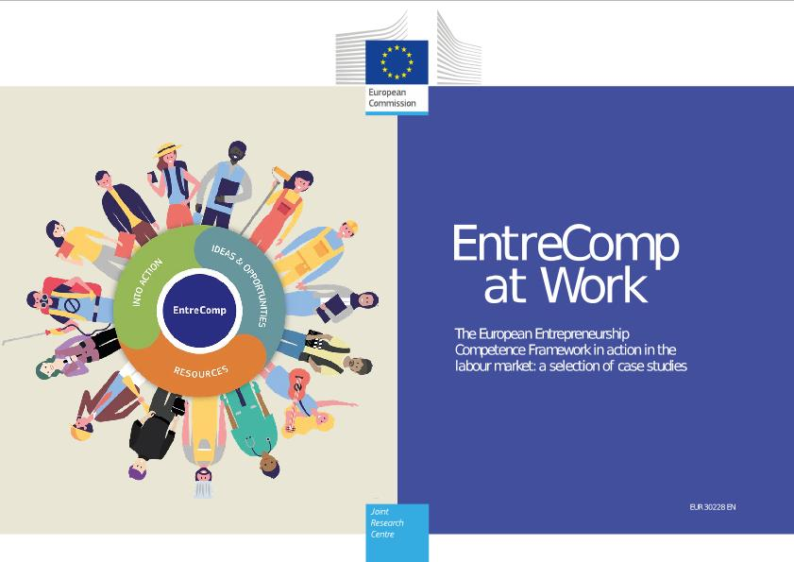
Unit 1
Section 4 – A follow-up to EntreComp
Unlike the DigComp (The Digital Competence Framework for Citizens) which is periodically reviewed by the European Commission’s JRC, after its publication the EntreComp has not undergone significant changes in terms of structure and content.
However, we cannot fail to mention two interesting and relevant follow-up publications, respectively in 2018 and 2020:
The European Commission's support for the production of this publication does not constitute an endorsement of the contents, which reflect the views only of the authors, and the Commission cannot be held responsible for any use which may be made of the information contained therein.

Slide 11
Unit 1
Section 4 – EntreComp into Action. Get inspired, make it happen
The EntreComp into Action followed two years after the original release of the framework and it is intended as a sort of manual for stakeholders in the domain of education and training to apply the EntreComp in their operational context.
It includes detailed guidelines on the framework and its opportunities from replicability and transfer into educational settings – school and secondary education, HE’s ecosystems, VET and Adults’ training – and embraces a very diverse cohort of targets.
Moreover, EntreComp into Action lists a large series of initiatives implemented at EU and cross-national level that the European Commission selected as case studies for its application. Users can capitalize on others’ experience so as to seek for best practices and further inspiration material.
The European Commission's support for the production of this publication does not constitute an endorsement of the contents, which reflect the views only of the authors, and the Commission cannot be held responsible for any use which may be made of the information contained therein.

Slide 12
Unit 1
Section 5 – EntreComp and Intangible Cultural Heritage
The EntreComp has many, one of which is certainly represented by the fact that the framework can be applied regardless of the target industry of social context.
By redesigning entrepreneurship, the framework can potentially navigate across all domains of societies, including Intangible heritage and culture.
Profiles operating in these sectors can rely on the EntreComp to self-assess and evaluate their professional competences so as to be more effective and efficient in their activities, tasks, and overall performance – in other words, to be more “entrepreneurial”.
In this specific context, we will focus on planning and execution of business ideas and we will do that by looking at one specific angle of the EntreComp: IDEAS & OPPORTUNITIES
The European Commission's support for the production of this publication does not constitute an endorsement of the contents, which reflect the views only of the authors, and the Commission cannot be held responsible for any use which may be made of the information contained therein.

Slide 13
Unit 2
Section 1 – A brief guide through the EntreComp framework (1)
Recalling the seventh competence from the LLL framework recommended by EU Parliament and Council, the policy paper provides for a further breakdown of Sense of Initiative and Entrepreneurship.
Comments indicates that the very core of this competence is about the ability to identify available opportunities for personal, professional and/or business activities, including ‘bigger picture’ issues that provide the context in which people live and work.
Ten years later, this ability happens to be reconducted to 15 key competences distributed across three key areas of training (see next slide):
The European Commission's support for the production of this publication does not constitute an endorsement of the contents, which reflect the views only of the authors, and the Commission cannot be held responsible for any use which may be made of the information contained therein.

Slide 14
Unit 2
Section 1 – A brief guide through the EntreComp framework (2)
More in details, the previous “Sense of Initiative and Entrepreneurship” is now represented by:
→ 3 Training areas…
→ …each of which including five competences…
→ for a total of 60 threads among all competences (what that competence stand for in practice)
→ which can be assessed based on a 8-dimension proficiency level…
→ …resulting in 442 learning outcomes
The European Commission's support for the production of this publication does not constitute an endorsement of the contents, which reflect the views only of the authors, and the Commission cannot be held responsible for any use which may be made of the information contained therein.

Slide 15
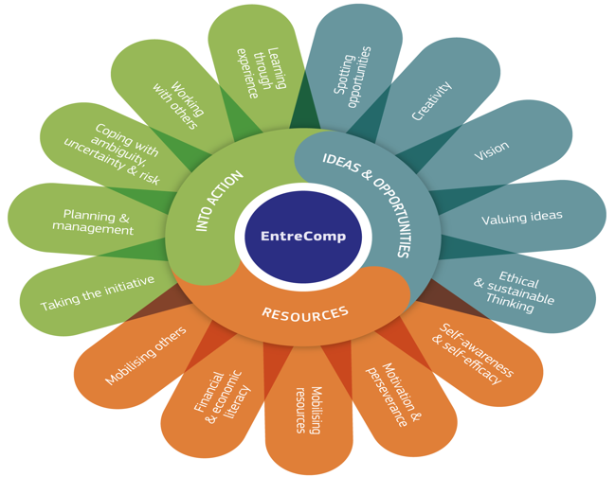
Unit 2
EntreComp’s training areas and competences associated to them
The European Commission's support for the production of this publication does not constitute an endorsement of the contents, which reflect the views only of the authors, and the Commission cannot be held responsible for any use which may be made of the information contained therein.

Slide 16
Unit 2
Section 2 – The 8-dimension proficiency model:
Foundation |  | Intermediate |  | Advanced |  | Expert
Relying on support from others |  | Building independence |  | Taking responsibility |  | Driving transformation, innovation and growth
Under direct supervision | With reduced support from others, some autonomy and together with my peers. | On my own and together with my peers. | Taking and sharing some responsibilities. | With some guidance and together with others. | Taking responsibility for making decisions and working with others. | Taking responsibility for contributing to complex developments in a specific field. | Contributing substantially to the development of a specific field.
Discover | Explore | Experiment | Dare | Improve | Reinforce | Expand | Transform
Source: EntreComp Progression model, pp. 16
The European Commission's support for the production of this publication does not constitute an endorsement of the contents, which reflect the views only of the authors, and the Commission cannot be held responsible for any use which may be made of the information contained therein.

Slide 17
Unit 2
Section 3 – IDEAS & OPPORTUNITIES
Competence | Hint | Description
1.1 Spotting opportunities | Use your imagination and abilities to identify opportunities for creating value | Identify and seize opportunities to create value by exploring the social, cultural and economic landscape Identify needs and challenges that need to be met Establish new connections and bring together scattered elements of the landscape to create opportunities to create value
1.2 Creativity | Develop creative and purposeful ideas | Develop several ideas and opportunities to create value including better solutions to existing and new challenges Explore and experiment with innovative approaches Combine knowledge and resources to achieve valuable effects
1.3 Vision | Work towards your vision of the future | Imagine the future Develop a vision to turn ideas into action Visualise future scenarios to help guide effort and action
1.4 Valuing Idea | Make the most of ideas and opportunities | Judge what value is in social, cultural and economic terms Recognise the potential an idea has for creating value and identify suitable ways of making the most out of it
1.5 Ethical and Sustainable thinking | Assess the consequences and impact of ideas, opportunities and actions | Assess the consequences of ideas that bring value and the effect of entrepreneurial action on the target community, the market, society and the environment Reflect on how sustainable long-term social, cultural and economic goals are, and the course of action chosen Act responsibly
The European Commission's support for the production of this publication does not constitute an endorsement of the contents, which reflect the views only of the authors, and the Commission cannot be held responsible for any use which may be made of the information contained therein.

Slide 18
Unit 2
Section 4 – RESOURCES
Competence | Hint | Description
2.1 Self-awareness and self-efficacy | Believing in yourself and keep developing | Reflect on your needs, aspirations and wants in the short, medium and long term Identify and assess your individual and group strengths and weaknesses Believe in your ability to influence the course of events, despite uncertainty, setbacks and temporary failures
2.2 Motivation and perseverance | Stay focused and don’t give up | Be determined to turn ideas into action and satisfy your need to achieve Be prepared to be patient and keep trying to achieve your long-term individual or group aims Be resilient under pressure, adversity, and temporary failure
2.3 Mobilising resources | Gather and manage the resources you need | Get and manage the material, non-material and digital resources needed to turn ideas into action Make the most of limited resources Get and manage the competences needed at any stage, including technical, legal, tax and digital competences
2.4 Financial and Economic literacy | Develop financial and economic know-how | Estimate the cost of turning an idea into a value-creating activity Plan, put in place and evaluate financial decisions over time Manage financing to make sure your value-creating activity can last over the long term
2.5 Mobilising others | Inspire, enthuse and get others on board | Inspire and enthuse relevant stakeholders Get the support needed to achieve valuable outcomes Demonstrate effective communication, persuasion, negotiation and leadership
The European Commission's support for the production of this publication does not constitute an endorsement of the contents, which reflect the views only of the authors, and the Commission cannot be held responsible for any use which may be made of the information contained therein.

Slide 19
Unit 2
Section 5 – INTO ACTION
Competence | Hint | Description
3.1 Taking the initiative | Go for it | Initiate processes that create value Take up challenges Act and work independently to achieve goals, stick to intentions and carry out planned tasks
3.2 Planning and Management | Priorities, organize and follow-up | Set long-, medium- and short-term goals Define priorities and action plans Adapt to unforeseen changes
3.3 Coping with uncertainty, ambiguity & risk | Make decision dealing with uncertainty, ambiguity and risk | Make decisions when the result of that decision is uncertain, when the information available is partial or ambiguous, or when there is a risk of unintended outcomes Within the value-creating process, include structured ways of testing ideas and prototypes from the early stages, to reduce risks of failing Handle fast-moving situations promptly and flexibly
3.4 Working with others | Team up, collaborate and network | Work together and co-operate with others to develop ideas and turn them into action Network Solve conflicts and face up to competition positively when necessary
3.5 Learning through experience | Learn by doing | Use any initiative for value creation as a learning opportunity Learn with others, including peers and mentors Reflect and learn from both success and failure (your own and other people’s)
The European Commission's support for the production of this publication does not constitute an endorsement of the contents, which reflect the views only of the authors, and the Commission cannot be held responsible for any use which may be made of the information contained therein.

Slide 20
Unit 3
Section 1 – The IDEAS & OPPORTUNITIES’ pillar: a detailed overview
In the context of the last unit of this module, we will focus on the first training area of the EntreComp framework.
We will go through each competence and each competence’s thread so as to help targets in embracing a new sense of initiative that starts with the critical thinking of new creative opportunities for ICH.
For further insights on other competences’ threads, users are recommended to look into the Part D of EntreComp Into Action (page 178).
The European Commission's support for the production of this publication does not constitute an endorsement of the contents, which reflect the views only of the authors, and the Commission cannot be held responsible for any use which may be made of the information contained therein.

Slide 21
Unit 3
Section 2 – 1.1 Spotting Opportunities: Identify, create and seize opportunities
Identifying and creating opportunities translates into developing a critical sense on the surrounding environment, while being able to apply different approaches to generate value for the organization.
Opportunities are not only for profit, as in the sense of EntreComp opportunities are also conceived as social, cultural and economic landscape to which capitalize on to generate benefits and positive outcomes for the community of belonging.
The methodology should be very analytical, practical and goal-oriented. However, people remains strongly encouraged to experiment with their creativity and lateral thinking so as to be better prepared in fostering innovation and development for the social and economic return of all interested parties.
The European Commission's support for the production of this publication does not constitute an endorsement of the contents, which reflect the views only of the authors, and the Commission cannot be held responsible for any use which may be made of the information contained therein.

Slide 22
Unit 3
Section 2 – 1.1 Spotting Opportunities: Focus on challenges
Sense of initiatives and entrepreneurial spirits might not necessarily match an opportunity on which to leverage on…on the other way, they might emerge in response to challenges (i.e., economic, social and cultural).
In the case of opportunities, entrepreneurs find creative/innovative solutions that boost and foster even further the intrinsic potentials of the opportunity itself.
In the case challenges, entrepreneurs find creative/innovative solutions that contain and prevents negative spill-out effects that might generate from the challenge itself if not properly and timely tackled.
Eventually, entrepreneurs with a far-sighted vision a capable of turning challenges into opportunities so as to valorise even further the socio-economic and cultural ecosystem they operate in.
The European Commission's support for the production of this publication does not constitute an endorsement of the contents, which reflect the views only of the authors, and the Commission cannot be held responsible for any use which may be made of the information contained therein.

Slide 23
Unit 3
Section 2 – 1.1 Spotting Opportunities: Undercover needs
As per definition, “needs” are in-between opportunities and challenges, depending on their specific nature and scale.
More usually, entrepreneurs treat needs ad opportunities as they have the unique ability to tackle that uncovered area of interest with new sophisticated, catchy, appealing and user-friendly solutions. The undercovering of needs requires for in-depth market/sector/industry analysis that are common of Marketing’s toolbox.
In general, entrepreneurs seek on a daily basis for unmatched/unsatisfied needs that they can cover with their offer before (and better) of any other competitor in the market.
The competitive advantage of many enterprise and large organization lies of the fact that they have been the “first mover” on a specific sector, while taking the risk to experiment with the unknown without being able to rely on others’ lessons and good practices applied to the same given context
The European Commission's support for the production of this publication does not constitute an endorsement of the contents, which reflect the views only of the authors, and the Commission cannot be held responsible for any use which may be made of the information contained therein.

Slide 24
Unit 3
Section 2 – 1.1 Spotting Opportunities: Analyse the context
Regardless of the origins and “roots” of the entrepreneurial initiative (opportunities, challenges, needs), creating value for the organization and people revolving around it is firstly and foremost a matter of embracing a culture that is open and very sensitive and responsive to internal weaknesses and external threats.
Defining strengths and opportunities is relatively easy compared to the previous two, as the analysis of threats and weaknesses faces entrepreneurs against their fears and common biases, and which tempt to remains underestimated or completely overlooked.
Skillful context’s analyses take full consideration of the meso-, micro-, and macro-level of the context, with great focus on details as well as the “big picture” emerging from their synergies and interrelations.
The European Commission's support for the production of this publication does not constitute an endorsement of the contents, which reflect the views only of the authors, and the Commission cannot be held responsible for any use which may be made of the information contained therein.

Slide 25
Unit 3
Section 3 – 1.2 Creativity: Be curious and open
The important thing is not to stop questioning. Curiosity has its own reason for existing. One cannot help but be in awe when one contemplates the mysteries of eternity, of life, of the marvellous structure of reality. It is enough if one tries to comprehend only a little of this mystery every day.
Einstein A.
Entrepreneurs will never be able to find to new ways to generate value from opportunities, challenges and needs if they are not willing to open themselves to the surrounding environment.
Take some time to familiarise with the new “pop” trends people are passionate about, what drives the interest of your community of reference, more in general, what is happening out there…
The European Commission's support for the production of this publication does not constitute an endorsement of the contents, which reflect the views only of the authors, and the Commission cannot be held responsible for any use which may be made of the information contained therein.

Slide 26
Unit 3
Section 3 – 1.2 Creativity: Developing an idea
Our species is about 200.000 years old. It is in our DNA to come up with alternative and innovative solutions to progress and develop as a living beings.
From the discovery of the wheel to the conquest of space, we never stopped developing new ideas to widen the horizons of our opportunities.
Entrepreneurship is about testing, piloting and validating new ideas to generate value so as to sustain the technological and social development of our societies. Eventually they will fail in the process, but rather than a threat, failure is the opportunity to get back valuable feedbacks and key lessons learned that build up skills, expertise, confidence.
I haven't failed two thousand times to make a light bulb; I simply found nineteen-ninety-nine ways of how a light bulb shouldn't be made.
Edison T.
The European Commission's support for the production of this publication does not constitute an endorsement of the contents, which reflect the views only of the authors, and the Commission cannot be held responsible for any use which may be made of the information contained therein.

Slide 27
Unit 3
Section 3 – 1.2 Creativity: Define problems
It is said that by simply knowing the nature of the problem, you are already halfway close to its solution.
Entrepreneurs cannot come up with innovative solutions to unknown problems, they need to be well aware of “what they are dealing with” before approaching suitable countermeasures. Any misunderstanding of the underling phenomenon might results in expensive waste of time and resources.
Highly relevant is also the approach that entrepreneurs put in practice to address the “problem”. Problems and challenges come in the shape of 3D prism, each surface has its own proprieties, which cumulated together contribute to the complexity of the phenomenon.
Systemic thinking is the antidote to any potential misjudgement which could lead entrepreneurs to drift from the most suitable and comprehensive solution.
The European Commission's support for the production of this publication does not constitute an endorsement of the contents, which reflect the views only of the authors, and the Commission cannot be held responsible for any use which may be made of the information contained therein.

Slide 28
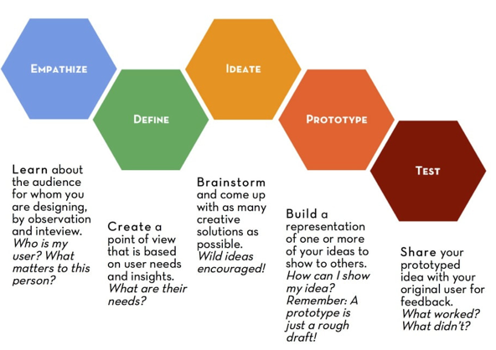
Unit 3
Section 3 – 1.2 Creativity: Design value
Lately, “design thinking” seems to be a very recurrent buzz word among academic and professionals.
In its most streamlined definition, design thinking is about cognitive, technical and strategic processes/tasks that lead to the design/engineering of infrastructures, products and services.
Design thinking can be applied to “ideas that generates values” as well. The reference model for design thinking to which many take inspiration is proposed by the Design Thinking Lab of Stanford University ( commonly referred to as d.school)
Source: https://dschool.stanford.edu/
The European Commission's support for the production of this publication does not constitute an endorsement of the contents, which reflect the views only of the authors, and the Commission cannot be held responsible for any use which may be made of the information contained therein.

Slide 29
Unit 3
Section 3 – 1.2 Creativity: Be innovative
In literature and in practice, it is very common to talk about four main kinds of innovation:
INCREMENTAL: the most common form of innovation that one can observe. It consists of already known technologies – applied to already known market – but updated with new features and characteristics.
DISRUPTIVE: disruptive technologies are not as common ad incremental ones, but still very frequent. It consists of new technologies applied to already known markets.
ARCHITECTURAL: architectural technologies are a bit more sophisticated compared to incremental and disruptive since the concept implies the application and exploitation of existing technologies to new markets so as to leverage on economies of scale, scope and experience
RADICAL: innovation ad per definition. New technologies applied to new markets.
The European Commission's support for the production of this publication does not constitute an endorsement of the contents, which reflect the views only of the authors, and the Commission cannot be held responsible for any use which may be made of the information contained therein.

Slide 30
Unit 3
Section 4 – 1.3 Vision: Imagine
As some said, imagination is more important then knowledge…
There is a countless number of ways in which imagination applies to entrepreneurship and business management. Imagination embraces many of the competences and threads included in EntreComp.
Taken individually, imagination can be interpreted as the ability to:
Create future scenarios that are desirable for both the organisation and surrounding communities
Define a strategic vision for the organisation and the value of its offer
Foreseen the long-term impacts of ones’ activities and processes
Evaluate and benchmark at the same time two or multiple possible scenarios
Strategize plans for risk management and coherent countermeasures
The European Commission's support for the production of this publication does not constitute an endorsement of the contents, which reflect the views only of the authors, and the Commission cannot be held responsible for any use which may be made of the information contained therein.

Slide 31
Unit 3
Section 4 – 1.3 Vision: Think strategically
Again, as per Imagination, strategic thinking can be potentially applied to all EntreComp’s competences as it is one of the most transversal and trans-functional skills that one might develop.
A strategic vision is designed so as to offer values for all, generate consensus and sense of belonging to the cause, and an inclusive perception of the surrounding ecosystem.
Strategic thinking means being able to orientate actions so as to proactively contribute to the emergence of the desired outcomes. In plainer words, it translate into the development of a consistent workplan capable of generating the expected results.
From a business’ angle, it means also leaving nothing to chance: set objectives that realistically achievable as well as challenging and motivation, measure your performance, compare your results to qualitative standards, apply the appropriate adjustments (if needed).
The European Commission's support for the production of this publication does not constitute an endorsement of the contents, which reflect the views only of the authors, and the Commission cannot be held responsible for any use which may be made of the information contained therein.

Slide 32
Unit 3
Section 4 – 1.3 Vision: Guide action
This is really about setting the stage to turn plans and visions into concrete actions.
In this stage, entrepreneurs go back to their drawing board and promote changes, revisions and reviews to what previously discussed, based on outcomes and results from an ongoing cycle of design thinking. Entrepreneurs take their time to finalise the roadmap of their performance, and open themselves to constructive feedbacks from external point of views.
Not only they identify any change that might be needed, but apply themselves so that these changes are actually implemented, still with a very clear view in mind of where they are moving toward and why.
The European Commission's support for the production of this publication does not constitute an endorsement of the contents, which reflect the views only of the authors, and the Commission cannot be held responsible for any use which may be made of the information contained therein.

Slide 33
Unit 3
Section 5 – 1.4 Valuing ideas: Recognise the value of ideas
This stage represents the “selling point” of the business idea and value’s offer.
Entrepreneurs can talk of their organisation so as to generate a great sense of enthusiasm in others. This exercise of storytelling has in reality some very impactful implications when, for instance, entrepreneurs meet in person important public stakeholders and/or private investors.
The value of ideas stands on how this ideas can generate value, for the organisation and for all the people involved (i.e., employees and society at large).
The profitability of the organisation does not detain its ultimate value: it is the business model that by shaping and valorising the offer of the organisation, contributes to its performance measured in terms of efficacy of processes, effectiveness of results, social benefits.
The European Commission's support for the production of this publication does not constitute an endorsement of the contents, which reflect the views only of the authors, and the Commission cannot be held responsible for any use which may be made of the information contained therein.

Slide 34
Unit 3
Section 5 – 1.4 Valuing ideas: Share and protect ideas
Theoretically speaking, it is possible to breakdown competence into two pieces, one for “share”, and one for “protect”:
Share: public relations, networking. In other words, communicating brand’s values to the outside. The very first target is of course represented by (potential) customers, but entrepreneurs never forget about the importance to establish their brand – and the value of their offer – to relevant third parties that might have a very significant impact on the organisation’s performance, such as public authorities, financial intermediaries, civil society at large, groups of interests from third sector, etc.
Protect: entrepreneurs should familiarise at least with the very basics of copyrighting and the many form of licensees that apply to the private market.
The European Commission's support for the production of this publication does not constitute an endorsement of the contents, which reflect the views only of the authors, and the Commission cannot be held responsible for any use which may be made of the information contained therein.

Slide 35
Unit 3
Section 6 – 1.5 Ethical and Sustainable thinking: Behave ethically
Ethics is a pervasive topic in business management. There is not a single function/dimension of entrepreneurship that can alienates to ethics. In this context, ethical thinking translates into acting in compliance with moral principles, putted even before any profit-driven logic.
Ethics-lead decision making processes will always prevail against any revenues-lead reasoning. As of today, the discussions with focus on Corporate Social Responsibility are as relevant as ever since societies are becoming increasingly more sensitives on many diverse social issues:
Gender inequality
Environment
Animal rights
Wealth inequalities
Etc.
The European Commission's support for the production of this publication does not constitute an endorsement of the contents, which reflect the views only of the authors, and the Commission cannot be held responsible for any use which may be made of the information contained therein.

Slide 36
Unit 3
Section 6 – 1.5 Ethical and Sustainable thinking: Assess impact
It is very common nowadays for organisation to submit annually their social report, in conjunction with “traditional” annual financial and economic statements.
A social report is submitted on a voluntarily basis and valorises organisation’s efforts in terms of social responsibility and environmental sustainability. With this document, entrepreneurs make available to public’s opinion their commitment to tackle and intervene on social issues that might of particular interest for third parties and public stakeholders.
That way, the organisation gives proof of its coherence with the values that it actively promotes. From another perspective, the social report establishes the reliability and trustworthiness of the organisation among the public, and generate great positive outcomes for its reputation.
The European Commission's support for the production of this publication does not constitute an endorsement of the contents, which reflect the views only of the authors, and the Commission cannot be held responsible for any use which may be made of the information contained therein.

Slide 37
Unit 3
Section 6 – 1.5 Ethical and Sustainable thinking: Be accountable
This is strictly related to impacts assessment, as entrepreneurs own accountability strengthen a direct communication channels with stakeholder groups that might interested in the sustainability and social responsibility of the organisation.
What follows is the reinforcement of a trust-based relationship that facilitates the exchange of information and mutual transparency, bilateral engagement and reliability.
Entrepreneurs are fully aware of the implications that come with the distinction between output, outcome and impact, while able to discern on which level their activates and challenges are referring to.
The European Commission's support for the production of this publication does not constitute an endorsement of the contents, which reflect the views only of the authors, and the Commission cannot be held responsible for any use which may be made of the information contained therein.

Slide 38
Summing Up
EntreComp’s follow up
EntreComp’s policy background
Two more frameworks for education and training on lifelong learning
8 key competences for lifelong learning
EnteComp: content and structure
Three key training areas to enhance your entrepreneurial spirits and sense of initiative in ICH
EntreComp’s threads
18 sub-competences for entrepreneurial excellence in ICH
IDEAS & OPPORTUNITIES
Additional resources
1.1 Spotting opportunities
1.2 Creativity
1.3 Vision
1.4 Valuing Idea
1.5 Ethical and Sustainable thinking
EntreComp into Action and EntreComp at work: case studies and good practices

Slide 39
THANK YOU

