Slide 1
Financial Education and Management Literacy for ICH operators IDP European Consultants

Slide 2
OBJECTIVES AND GOALS
At the end of this module you will be able to:
Familiarise with the Entrecomp approach to management literacy
Write specific reference to the competences and sub-competences envisioned by EntreComp ad instrumental for financial literacy
Assess your progression in management literacy
In the context of this unit, you will find available a 8-level progression model that you can use to self-assess your new competence son knowledge on the matter
Exploit new tools, frameworks and techniques for strategic management
At the end of the module, we will present readers robust and consolidated management frameworks for businesses and operations that can be easily applied in ICH sectors.
The European Commission's support for the production of this publication does not constitute an endorsement of the contents, which reflect the views only of the authors, and the Commission cannot be held responsible for any use which may be made of the information contained therein.

Slide 3
INDEX
Unit 2
Unit 1
The toolbox for strategic management in ICH
Financial education and management literacy

Slide 4
Unit 1
Section 1 – Financial Education and Management Literacy: introduction notes
The topic of financial education and literacy is extremely relevant and very much debated. All largest International organisations seems to be particularly proactive in this specific training areas.
The World Bank, OECD, International Labour Organisation, United Nation came up all with their own international scale initiatives aimed at strengthening financial literacy – with particular reference to marginalised and disadvantaged communities, developing countries, rural areas, women and other targets at high risk of socio-economic marginalisation. A the efforts go on…
…for instance, as we speak, the European Commission is collaborating with the OECD to develop a Financial Competence Framework for the EU.
The European Commission's support for the production of this publication does not constitute an endorsement of the contents, which reflect the views only of the authors, and the Commission cannot be held responsible for any use which may be made of the information contained therein.

Slide 5
Unit 1
Section 2 – Financial Education and Management Literacy: an EntreComp’s approach
The Entrepreneurial competence framework developed by the JRC of the European Commission lists “Financial and Economic literacy” as a stand-alone competence to nurture, develop and strengthen sense of initiative and entrepreneurial spirit.
Financial and Economic literacy belongs to the second training area of the framework, the one related to RESOURCES, along with:
Self-awareness and self-efficacy
Motivation and perseverance
Mobilising resources
Mobilising others
The European Commission's support for the production of this publication does not constitute an endorsement of the contents, which reflect the views only of the authors, and the Commission cannot be held responsible for any use which may be made of the information contained therein.

Slide 6
Unit 1
Section 2 – 2.4 Financial and Economic Literacy
The EU Commission’s choice to gather this competence with the other listed in the previous slide is very interesting: while all the other competences of this area refer to attitudes and mindset, 2.4 is the only one at high technical-intensive coefficient.
In the view of the European Commission, being proficient in the basics of finance and economic is as a strategic resource for excellence and performance as being motivated, focused and inspired.
Eventually, you should keep in mind of that when dealing with difficult circumstances challenging your spirit, but also your technical and sector specific knowledge…
The European Commission's support for the production of this publication does not constitute an endorsement of the contents, which reflect the views only of the authors, and the Commission cannot be held responsible for any use which may be made of the information contained therein.

Slide 7
Unit 1
Section 3 – A deepen look into 2.4 (1)
As per framework, the competence is described as follows:
Competence | Hint | Description
2.4 Financial and Economic literacy | Develop financial and economic know-how | Estimate the cost of turning an idea into a value-creating activity Plan, put in place and evaluate financial decisions over time Manage financing to make sure your value-creating activity can last over the long term
The European Commission's support for the production of this publication does not constitute an endorsement of the contents, which reflect the views only of the authors, and the Commission cannot be held responsible for any use which may be made of the information contained therein.

Slide 8
Unit 1
Section 3 – A deepen look into 2.4 (2)
By assessing the previous table, we might notice that 2.4 is a competence with a three-dimension focus:
Budgeting and cost structuring
Finance-wise decisions making
Operative sustainability
In other words, the EntreComp seems linking under the same training areas both entrepreneurial aspirations and resilience , to the concrete and actual profitability of the idea: a keen sense of initiative and a fiery motivation might lead to a disaster if numbers (i.e., €) are not rationally pondered…
A great idea might not be necessarily financially viable (due to prohibitive investments or unsustainable profit margins). On the other hand a profitable idea is always a great idea to consider and work on…
The European Commission's support for the production of this publication does not constitute an endorsement of the contents, which reflect the views only of the authors, and the Commission cannot be held responsible for any use which may be made of the information contained therein.

Slide 9
Unit 1
Section 4 – Financial and Economic Literacy: threads and sub-competences
The EntreComp framework lists four detailed threads linked to competence no. 2.4 that are instrumental to master at least the essentials of finance and economics:
Understanding economic and financial concepts
Budget
Find funding
Understand taxation
For each of this thread, users can self-assess their proficiency level by referring to the 8-dimension progression model developed by the framework and generally applied to each thread of each competence.
The European Commission's support for the production of this publication does not constitute an endorsement of the contents, which reflect the views only of the authors, and the Commission cannot be held responsible for any use which may be made of the information contained therein.

Slide 10
Unit 1
Section 4 – Financial and Economic Literacy: Understanding economic and financial concepts
This competence is really about familiarising with common terminology used in business and management:
KPI
Break even point
Supply, demand and market price
Stock VS bonds
Price elasticity of demand
Economies of scale
Economies of learning
Strategic Business Unit
Diversification strategy
Value chain
Etc.
The European Commission's support for the production of this publication does not constitute an endorsement of the contents, which reflect the views only of the authors, and the Commission cannot be held responsible for any use which may be made of the information contained therein.

Slide 11
Unit 1
Section 4 – Financial and Economic Literacy: Budget
Budgeting is about being able to forecast cash flow needs per each cost category.
Each function requires a certain amount of economic resources to perform their given tasks: the final budget assigned to each function/process/team (depending on the label of the cost category) will result from reliable and robust estimations based, for instance, on benchmark with historical data.
Skilful budgeting comes with experience: as activates move on throughout time, entrepreneurs gather a critical mass of references and experience that will help them in better orienting their future budget-related decisions.
There are several methodologies that can be applied for budget planning and forecasting, we will go through them in the second unit of this module.
The European Commission's support for the production of this publication does not constitute an endorsement of the contents, which reflect the views only of the authors, and the Commission cannot be held responsible for any use which may be made of the information contained therein.

Slide 12
Unit 1
Section 4 – Financial and Economic Literacy: Find funding
…in other words, finding people willing to invest in the organisation/business idea in exchange for an interest rate.
The “traditional” funding source is represented by the banking system. However, nowadays there is a very large cohort of stakeholders from both the public and private sector that can be of interest for this specific tasks:
Super angels
Angels
Venture Capitalists
Crowdfunding
EU funding opportunities
Structural funds
EU programmes
For further details please refer to Unit 2.
The European Commission's support for the production of this publication does not constitute an endorsement of the contents, which reflect the views only of the authors, and the Commission cannot be held responsible for any use which may be made of the information contained therein.

Slide 13
Unit 1
Section 4 – Financial and Economic Literacy: Understand taxation
As per EntreComp framework, understanding taxation is about:
Foundation |  | Intermediate |  | Advanced |  | Expert
Relying on support from others |  | Building independence |  | Taking responsibility |  | Driving transformation, innovation and growth
Under direct supervision | With reduced support from others, some autonomy and together with my peers. | On my own and together with my peers. | Taking and sharing some responsibilities. | With some guidance and together with others. | Taking responsibility for making decisions and working with others. | Taking responsibility for contributing to complex developments in a specific field. | Contributing substantially to the development of a specific field.
Discover | Explore | Experiment | Dare | Improve | Reinforce | Expand | Transform
I can outline the purpose of taxation. | I can explain how taxation finances the activities of a country and its part in providing public goods and services. | I can estimate the main accountancy and tax obligations I need to fulfil to meet the tax requirements for my activities |  | I can estimate how my financial decisions (investments, buying assets, goods and so on) affect my tax. | I can make financial decisions based on current taxation schemes. | I can make financial decisions based on taxation schemes of different countries and territories.
The European Commission's support for the production of this publication does not constitute an endorsement of the contents, which reflect the views only of the authors, and the Commission cannot be held responsible for any use which may be made of the information contained therein.

Slide 14
Unit 2
Section 1 – The toolbox for business and strategic management: introduction to the unit
In the course of this unit, we want to provide users consolidated tools and models that they can rely on to strategize their organisations.
The tools that you are going to be exposed to represents the key essentials of your management literacy and will support you in:
Better understanding the concrete potentialities of your business
Scoping new opportunities and ways to bridge the gap with the market
Reaching for competitive advantage and higher performance standards
Please consider that these tools have not been developed in reference to a specific sector or industry. As such, they perfectly fit to Intangible Cultural Heritage and the markets you normally operate in.
The European Commission's support for the production of this publication does not constitute an endorsement of the contents, which reflect the views only of the authors, and the Commission cannot be held responsible for any use which may be made of the information contained therein.

Slide 15
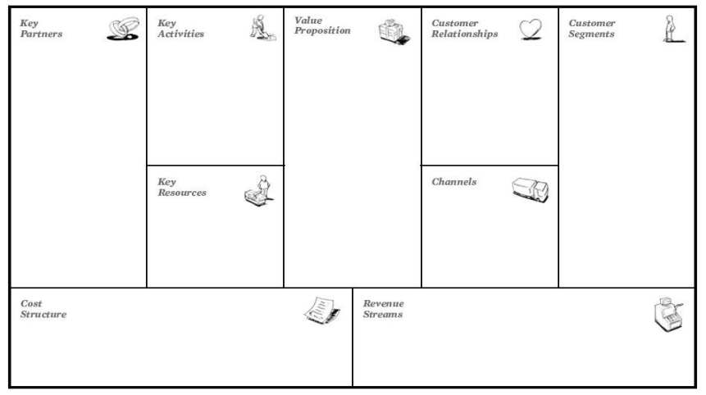
Unit 2
Section 2 – Business Model Canvas, BMC (1)
Source: Osterwalder, Alexander (2005). “What is a business model?”
The European Commission's support for the production of this publication does not constitute an endorsement of the contents, which reflect the views only of the authors, and the Commission cannot be held responsible for any use which may be made of the information contained therein.

Slide 16
Unit 2
Section 2 – Business Model Canvas, BMC (2)
As of today, the BMC remains the favourite tool for aspiring and established entrepreneurs to frame and conceptualize the business model of their organisation.
By business model we refer to the way in which and organisation/business generates value and pursuit economic sustainability.
The BMC is intended to be printed out and filled in by participants with post-it notes, graphs, drawings…whatever they feel like might generate a contribution. Typically, it is a teamwork activity but there is no real boundary to its use. Participants brainstorm together on the very core elements contributing to the definition of the business model.
The BMC includes nine clusters of resources to which these core elements might refer to. As users might notice, the design of the tools does not suggest for a standard fill order…as a matter of fact, users can proceed as they better wish for themselves, anyways here’s a tentative guideline for your consideration (next slide):
The European Commission's support for the production of this publication does not constitute an endorsement of the contents, which reflect the views only of the authors, and the Commission cannot be held responsible for any use which may be made of the information contained therein.

Slide 17
Unit 2
Section 2 – Business Model Canvas, BMC (3)
1. Key Partners Who are your key partners? Who are your key suppliers? Which key resources are we acquiring from partners? Which key activities do partners perform? | 2. Key Activities What key activates do our value proposition requires What about our distribution channels? What about our customer relationship? What about our revenue streams? | 3. Key Resources What key resources do our value proposition require? | 4. Value proposition What value do we deliver to the customers? Which one of our customers’ problems are we helping to solve? What bundles of product and services are we offering to each Customer Segment? Which customers’ needs are we satisfying? | 5. Customer Relationship What type of relationship does each of our customer segment expects us to establish and maintain with them? Which ones have we established? How are they integrated with the rest of our business model? How costly are they? (or might be?) | 6. Customer Segment(s) For whom are we creating value? Who are our most important customers? | 7. Channels Through which channels do our customer segments want to be reached? How are we going to reach them? How our channels might be integrated? Which ones are more cost-efficient? | 8. Cost Structure What are the most important costs inherent in our business model? Which key resources and activities are most expensive? | 9. Revenue Streams For what value are our customers really willing to pay? How much they would prefer to pay?
The European Commission's support for the production of this publication does not constitute an endorsement of the contents, which reflect the views only of the authors, and the Commission cannot be held responsible for any use which may be made of the information contained therein.

Slide 18
Unit 2
Section 3 – Budgeting and cost structure (1)
Talking about 8. Cost Structure and 9. Revenue Streams, we take this opportunity to go back to the EntreComp’s thread of Budget so as to present the most common methodologies for cost structuring and budget forecasting:
ANALOGUE: benchmarking from past (and similar!) experiences
PARAMETRIC: historical data are recalculated on the basis of the current circumstances
TOP-DOWN: from the grand amount, distribute the budget on each specific cost-category
BOTTOM-UP: from the budget allocated to each cost category, generate the overall budget (and discuss about it)
The European Commission's support for the production of this publication does not constitute an endorsement of the contents, which reflect the views only of the authors, and the Commission cannot be held responsible for any use which may be made of the information contained therein.

Slide 19
Unit 2
Section 3 – Budgeting and cost structure (2)
Is there a budgeting methodology better than the other? …no, there isn’t.
The applied methodology really depended on the given context – for instance, In the case we dispose of robust and reliable historic data and information, the ANALOGUE methodology represent certainly the way to go…
In general, the allocation of the budget should be compliant to three guiding criteria:
Consistency
Impact
Sustainability
In other words, is the allocated budget coherent to the resources absorbed by the given task/process/working group, etc.?
The European Commission's support for the production of this publication does not constitute an endorsement of the contents, which reflect the views only of the authors, and the Commission cannot be held responsible for any use which may be made of the information contained therein.

Slide 20
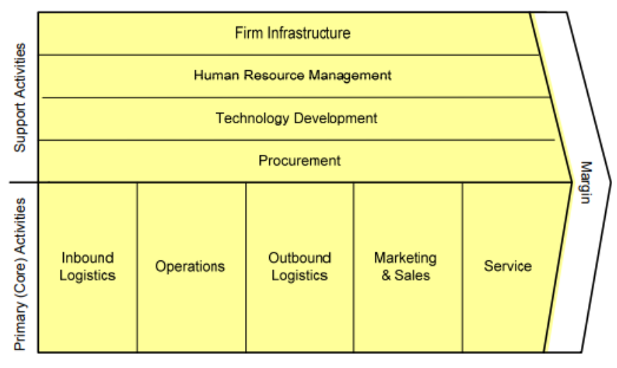
Unit 2
Section 4 – Porter’s Value Chain (1)
Source: Michael E. Porter, Competitive Advantage, 1985, p.87
The European Commission's support for the production of this publication does not constitute an endorsement of the contents, which reflect the views only of the authors, and the Commission cannot be held responsible for any use which may be made of the information contained therein.

Slide 21
Unit 2
Section 4 – Porter’s Value Chain (2)
Another acclaimed model to “visualise” a firm’s value equation is the so defined Value Chain. In the view of this framework, an organisation is an ongoing process of activities that transform raw materials in goods and services for the public.
Business’ activates are divided into two categories:
Primary (Core) Activities: those that directly contribute to the generation of outputs.
Support Activities: those that are instrumental to the processing of inputs, and without which outputs could not be generated by Primaries.
The European Commission's support for the production of this publication does not constitute an endorsement of the contents, which reflect the views only of the authors, and the Commission cannot be held responsible for any use which may be made of the information contained therein.

Slide 22
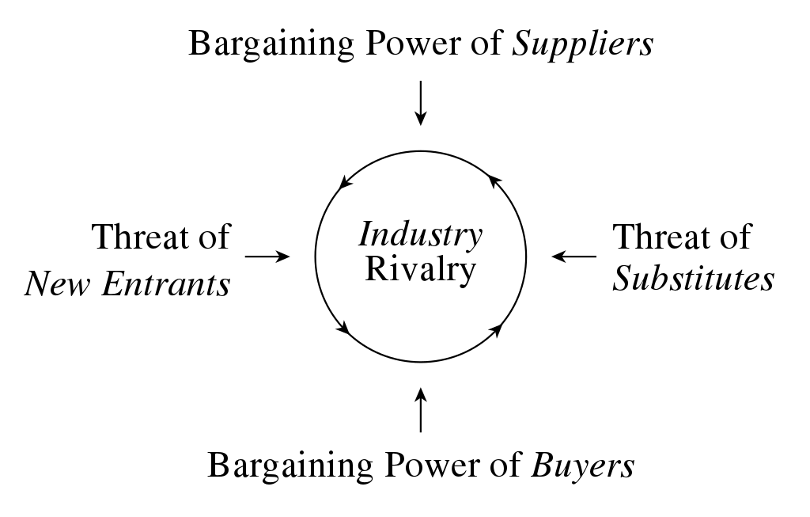
Unit 2
Section 5 – Porter’s Five Forces (1)
Source: Michael E. Porter, “How Competitive Forces Shape Strategy”, Harvard Business Review, May 1979 (Vol. 57, No. 2), pp. 137–145.
The European Commission's support for the production of this publication does not constitute an endorsement of the contents, which reflect the views only of the authors, and the Commission cannot be held responsible for any use which may be made of the information contained therein.

Slide 23
Unit 2
Section 5 – Porter’s Five Forces (2)
We also owe to Michael Porter another cornerstone of strategic business management.
The Model of Five Forces is a reference framework to analysis and assess the competitive dynamics of a specific industry/sector. The framework includes five variables (“forces”) shaping competition and the competitive challenges faced by an organisation.
New Entrants
Negotiating power of suppliers
Negotiating power of buyers
Substitute products (or services)
Competitors themselves
For further details on the framework, please visit: How Competitive Forces Shape Strategy, HBR
by Michael E. Porter
The European Commission's support for the production of this publication does not constitute an endorsement of the contents, which reflect the views only of the authors, and the Commission cannot be held responsible for any use which may be made of the information contained therein.

Slide 24
Unit 2
Section 5 – New forces on the horizon: integrating Porter’s model
Other authors integrated Porter’s efforts with new contributions and identified other sources capable of influencing the competitive potentials of an organisations:
Industry growth rate. It has been observed that fast rowing industries accelerate and “magnify” competitive dynamics as they attract new organisation and new investment
Technology and Innovation. New technologies tempt to provide for greater competitive margins (i.e., better customer experience, better usability of the product, or more in general, greater efficiency and effectiveness = cost reduction = higher margins of profit)
Government. A standalone force, as it can greatly influence the course of competitive advantage on many industries (defence, health care, energy, etc.).
Complementary products and services. Imagine if the entire automotive industry goes “electric”, what would the impact for oil companies?
The European Commission's support for the production of this publication does not constitute an endorsement of the contents, which reflect the views only of the authors, and the Commission cannot be held responsible for any use which may be made of the information contained therein.

Slide 25
Unit 2
Section 6 – The DEMING’s cycle (1)
Plan
Do
Check
Act
Deming, W.E., 1950. Elementary Principles of the Statistical Control of Quality, JUSE.
The European Commission's support for the production of this publication does not constitute an endorsement of the contents, which reflect the views only of the authors, and the Commission cannot be held responsible for any use which may be made of the information contained therein.

Slide 26
Unit 2
Section 6 – The DEMING cycle (2)
If your read any management handbook recently, it is highly possible that you stumbled across things such as Lean Manufacturing, Total Quality Management (TQM), Just In Time (JIT): audit framework applied in Japanese industry from the second half of the last century.
In reality, they all take inspiration from a US author, W. Edwards Deming, came in contact with Japan's’ industrials after the second World War.
As of today, the DEMING cycle remains one of the most consolidated, robust and reliable framework to evaluate organisational processes and their compliance to internal monitoring standards.
The model own its large-scale diffusion to its great ease of application, user-friendliness and linearity.
The European Commission's support for the production of this publication does not constitute an endorsement of the contents, which reflect the views only of the authors, and the Commission cannot be held responsible for any use which may be made of the information contained therein.

Slide 27
THANK YOU

