Slide 1
Interacting through digital technologies: communication & collaboration Municipality of Pescara

Slide 2
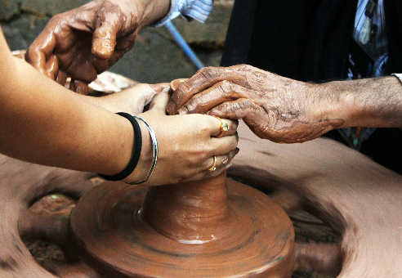
OBJECTIVES AND GOALS
At the end of this module you will be able to:
Familiarise with the EU framework for digital skills
In the first training unit, readers will have the opportunity to familiarise with the DigComp framework, the EU official reference model for training and education on IT skills
Understand the essentials of cooperation and collaboration in IT environments
The cooperation and collaboration pillar of the Dig Comp frameworks provides for key competences for effective and efficient cooperation dynamics in digital settings
Acquire new good practices for team management and stakeholders engagement in virtual contexts
At the end of this module, readers can find for their use consolidated and robust good practices for a trust-based and reliable communication with external parties, stakeholders and tem memebers.
The European Commission's support for the production of this publication does not constitute an endorsement of the contents, which reflect the views only of the authors, and the Commission cannot be held responsible for any use which may be made of the information contained therein.

Slide 3
INDEX
EXTRA
Unit 3
Case study
Unit 2
Good practices for interacting trough digital technologies
Unit 1
Collaboration and Communication Pillar
Brief Introduction to DigComp 2.1

Slide 4
Unit 1
Section 1 – DigComp 2.1: What exploitation opportunities?
The following content focuses on Interacting through digital technologies, a training area and competences emerged as particularly critical from the skills-gap and need assessment analysis conducted by partner throughout the first implementation cycle of NICHE.
The World Wide Web is flooded with materials on how to be more proficient with digital technologies from a in-remote communication and collaboration perspective. But in the context of this training module, our primary source of reference will be represented by the latest version of the Digital Competence Framework for Citizens published by the EU Commission’s Joint Research Centre in 2016.
More specifically, we will look into the competence area no.2 Communication and Collaboration, to which Interacting through digital technologies formally belongs to.
The European Commission's support for the production of this publication does not constitute an endorsement of the contents, which reflect the views only of the authors, and the Commission cannot be held responsible for any use which may be made of the information contained therein.

Slide 5
Unit 1
Section 2 – The official EU framework for training and education on digital skills
The first DigComp framework came out in 2013. The latest version is the DigComp 2.1 but it will be soon replaced by the DigComp 2.2 (available later in 2022).
The DigComp 2.1 includes 21 digital competences distributed among 5 competence (“training”) areas.
For each specific competence, it is available a 8-layer proficiency models that final users/teachers can rely on to track monitor and progresses in acquiring more robust proficiency with the given competences.
The European Commission's support for the production of this publication does not constitute an endorsement of the contents, which reflect the views only of the authors, and the Commission cannot be held responsible for any use which may be made of the information contained therein.

Slide 6
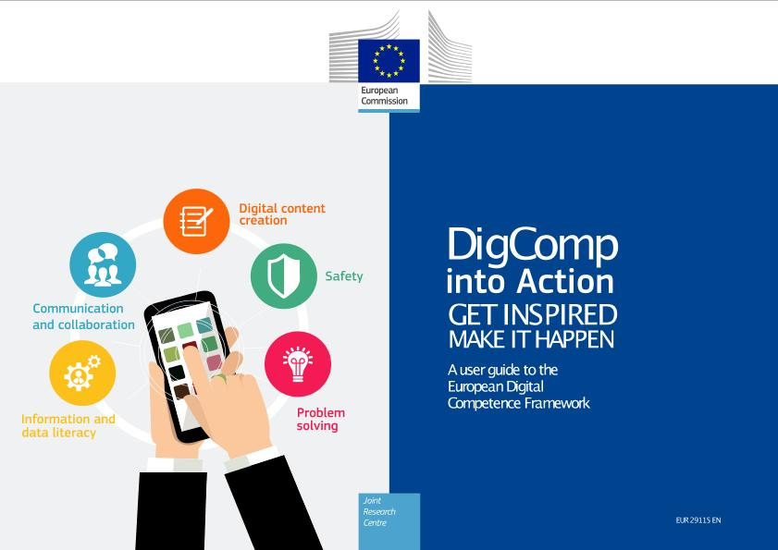
Unit 1
Section 3 – The extended bibliography of DigComp
As of today, between the official publication of the DigComp 2.1 and the release of the 2.2’s version, the European Commission extended DigComp’s bibliography with three additional resources:
The European Commission's support for the production of this publication does not constitute an endorsement of the contents, which reflect the views only of the authors, and the Commission cannot be held responsible for any use which may be made of the information contained therein.

Slide 7
Unit 2
Section 1 – Focusing on DigComp’s training area no.2
In Unit 1, we presented readers to the background and general outline of the DigComp framework so as to better introduce them to the content that will come next.
The Communication and collaboration pillar is further broken down into the following competences:
2. Communication and Collaboration
2.1 Interacting through digital technologies | 2.2 Sharing through digital technologies | 2.3 Engaging in citizenship through digital technologies | 2.4 Collaborating through digital technologies | 2.5 Netiquette | 2.6 Managing digital identity
Source: DigComp 2.1, page 11
The European Commission's support for the production of this publication does not constitute an endorsement of the contents, which reflect the views only of the authors, and the Commission cannot be held responsible for any use which may be made of the information contained therein.

Slide 8
Unit 2
Section 2 – Focusing on DigComp’s competence 2.1
As we can see, all six competences listed under the second competence area are closely interrelated each others:
Sharing, engaging and collaborating would not be possible without first interacting through digital technologies
Netiquette helps you to manage (and establish) your digital identity
Etc.
In other words, among this competences there is not a “strict” hierarchal order but rather a mutual-contamination effect, in which strengthening your proficiency with one of them, strengthen your expertise with all the others.
Talking about proficiency, the DigComp 2.1 came with a very clear progression model that help users in acquiring greater awareness on their expertise and know how.
The European Commission's support for the production of this publication does not constitute an endorsement of the contents, which reflect the views only of the authors, and the Commission cannot be held responsible for any use which may be made of the information contained therein.

Slide 9
Unit 2
Section 3 – Interacting through digital technologies
The European Commission's support for the production of this publication does not constitute an endorsement of the contents, which reflect the views only of the authors, and the Commission cannot be held responsible for any use which may be made of the information contained therein.

Slide 10
Unit 3
Section 1 – Resources and additional recommendations to interact through digital technologies
Firstly and foremost, it is essential to understand and be perfectly aware of who your organisation is interacting with and why…
A data driven interaction implies the competence of decoding digital data and information so as to be better equipped to navigate the digital ecosystem and orientate the strategic long-term vision of the organisation accordingly.
The most critical business functions are now fully data-driven: finance, sales and advertising rely on web-based exchanges of communication, inputs and insights, plus numerous other parameters to assess, monitor and evaluate the performance of the organisation and how its value-equation its perceived among (potential) customers.
The European Commission's support for the production of this publication does not constitute an endorsement of the contents, which reflect the views only of the authors, and the Commission cannot be held responsible for any use which may be made of the information contained therein.

Slide 11
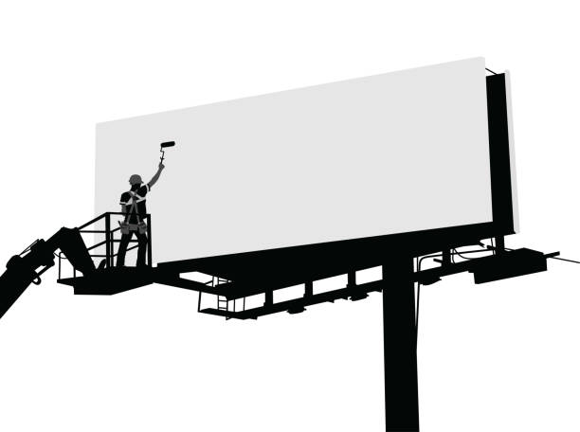
Unit 3
Section 1 – For instance, in branding:
From… | …to
The European Commission's support for the production of this publication does not constitute an endorsement of the contents, which reflect the views only of the authors, and the Commission cannot be held responsible for any use which may be made of the information contained therein.

Slide 12
Unit 3
Section 2 – the roadmap of online-based interactions with the external public
1. Set-up the target(s)
2. Adapt to the audience
3. Define the pillar(s)
4. Schedule a calendar
The European Commission's support for the production of this publication does not constitute an endorsement of the contents, which reflect the views only of the authors, and the Commission cannot be held responsible for any use which may be made of the information contained therein.

Slide 13
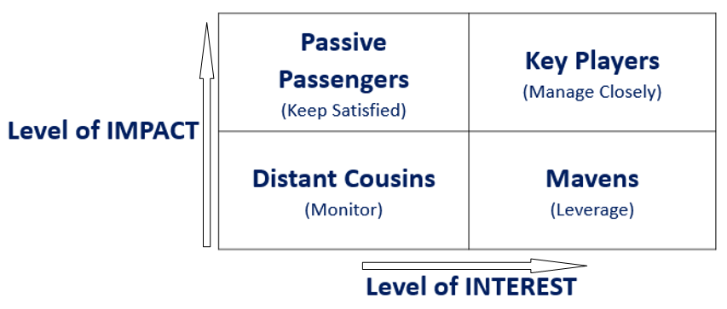
Unit 3
Section 2 – About targets…
…we do refer to the general cohort of social and economic actors identified as Group of Interest (aka Stakeholders) that:
might be impacted by the business activities
might have an impact and/or an interest on business activities
The POWER-INTEREST Matrix (Johnson and Scholes; 1999)
The European Commission's support for the production of this publication does not constitute an endorsement of the contents, which reflect the views only of the authors, and the Commission cannot be held responsible for any use which may be made of the information contained therein.

Slide 14
Unit 3
Section 2 – About targets…a monitoring tool
Keep track and record the progresses you make in communication and engagement per each od the identified stakeholder category: what is their current (C) level of involvement compered to the desired (D) status?
The European Commission's support for the production of this publication does not constitute an endorsement of the contents, which reflect the views only of the authors, and the Commission cannot be held responsible for any use which may be made of the information contained therein.

Slide 15
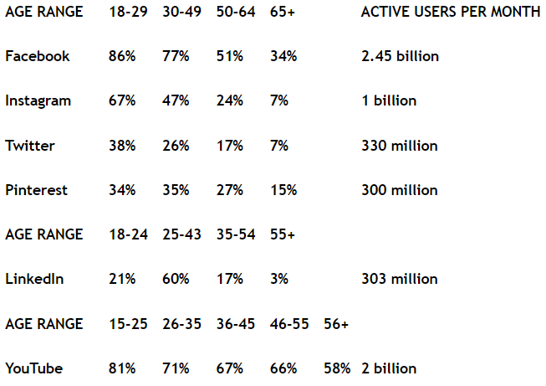
Unit 3
Section 2 – About the audience…
The European Commission's support for the production of this publication does not constitute an endorsement of the contents, which reflect the views only of the authors, and the Commission cannot be held responsible for any use which may be made of the information contained therein.

Slide 16
Unit 3
Section 2 – About the audience…and consistent means
Lifestyle, food or home Facebook, Pinterest and Instagram.
IT, business or industry LinkedIn and Twitter
Publishing videos YouTube, Facebook, Instagram
Publishing a poll Facebook, Twitter and Instagram
Pictures Instagram and Pinterest
Studies or opinion pieces Facebook and LinkedIn
Pictures and quotes Facebook and Instagram
Infographics Pinterest
Photo collage Pinterest
The European Commission's support for the production of this publication does not constitute an endorsement of the contents, which reflect the views only of the authors, and the Commission cannot be held responsible for any use which may be made of the information contained therein.

Slide 17
Unit 3
Section 3 – Interacting and communicating through digital technologies, internal communication
Sponsor
Partners
Organization
Team
The European Commission's support for the production of this publication does not constitute an endorsement of the contents, which reflect the views only of the authors, and the Commission cannot be held responsible for any use which may be made of the information contained therein.

Slide 18
Unit 3
Section 3 – Interacting and communicating through digital technologies, external communication
General Public
Stakeholder
Clients
Process
The European Commission's support for the production of this publication does not constitute an endorsement of the contents, which reflect the views only of the authors, and the Commission cannot be held responsible for any use which may be made of the information contained therein.

Slide 19
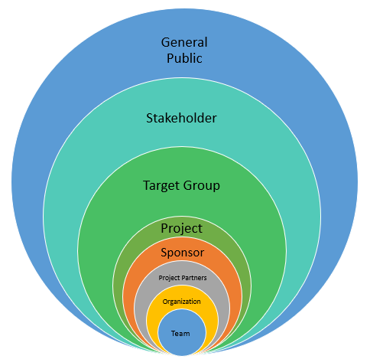
Unit 3
Section 3 – Interacting and communicating through digital technologies, communication means
Social Media
Internet
Mass Media
Events, conferences and seminars
Specialized media (print)
Training
Direct mailing and targeted communication (newsletter)
Reports
emails + meetings + telcom.
Personal emails + individual meetings + informal telcom.
The European Commission's support for the production of this publication does not constitute an endorsement of the contents, which reflect the views only of the authors, and the Commission cannot be held responsible for any use which may be made of the information contained therein.

Slide 20
Unit 3
Section 4 – What poor interaction leads to…
Poor Team Communications | Poor Stakeholder Communications
Misunderstanding around project goals and objectives | Lack of or limited buy-in and commitment to the project
Missed deadlines and conflicts between team members | Misunderstanding around stakeholder expectations on what is considered project success
Individual team members moving in different directions | Conflicts between the project team and stakeholders, or between stakeholder groups
Decreased productivity on the project leading to increased timelines and going over budget | Failing processes
Lack of commitment on the part of project team members in accomplishing the work of the project | Stakeholders who may actively work against the project being accomplished
The European Commission's support for the production of this publication does not constitute an endorsement of the contents, which reflect the views only of the authors, and the Commission cannot be held responsible for any use which may be made of the information contained therein.

Slide 21
Unit 3
Section 5 – Setting the stage of online interaction: final remarks of netiquette
Writing and receiving e-mail has become one of the most recurrent activities of our daily lives. Don’t forget to follow some specific business (n)etiquette rules that allows you being effective and clear.
Define a clear Subject: make sure the subject line is simple, specific, but catchy.
Start Your Email with Greetings
Writing and receiving e-mail has become one of the most recurrent activities of our daily lives. Don’t forget to follow some specific business (n)etiquette rules that allows you being effective and clear.
Define a clear Subject: make sure the subject line is simple, specific, but catchy.
Start Your Email with Greetings
Be Clear and Precise: save other’s time! We spend 13 hours a week or 28 % of the workweek managing emails (McKinsey)
Informal vs. Formal: choose your communication style on the basis of your recipient
Use (if necessary) attachments, be clear in explaining what they contain and the file format
Do not avoid to communicate bad news: try to propose solutions after a clear explication of the issue
Write a Closing to Your Email: choose the most suitable phrase before typing your name
Before sending read again your E-mail: most of the common mistakes or typos can be avoided by a careful re-reading with an eye to details
The European Commission's support for the production of this publication does not constitute an endorsement of the contents, which reflect the views only of the authors, and the Commission cannot be held responsible for any use which may be made of the information contained therein.

Slide 22
Unit 3
Section 5 – a bad email…
The European Commission's support for the production of this publication does not constitute an endorsement of the contents, which reflect the views only of the authors, and the Commission cannot be held responsible for any use which may be made of the information contained therein.

Slide 23
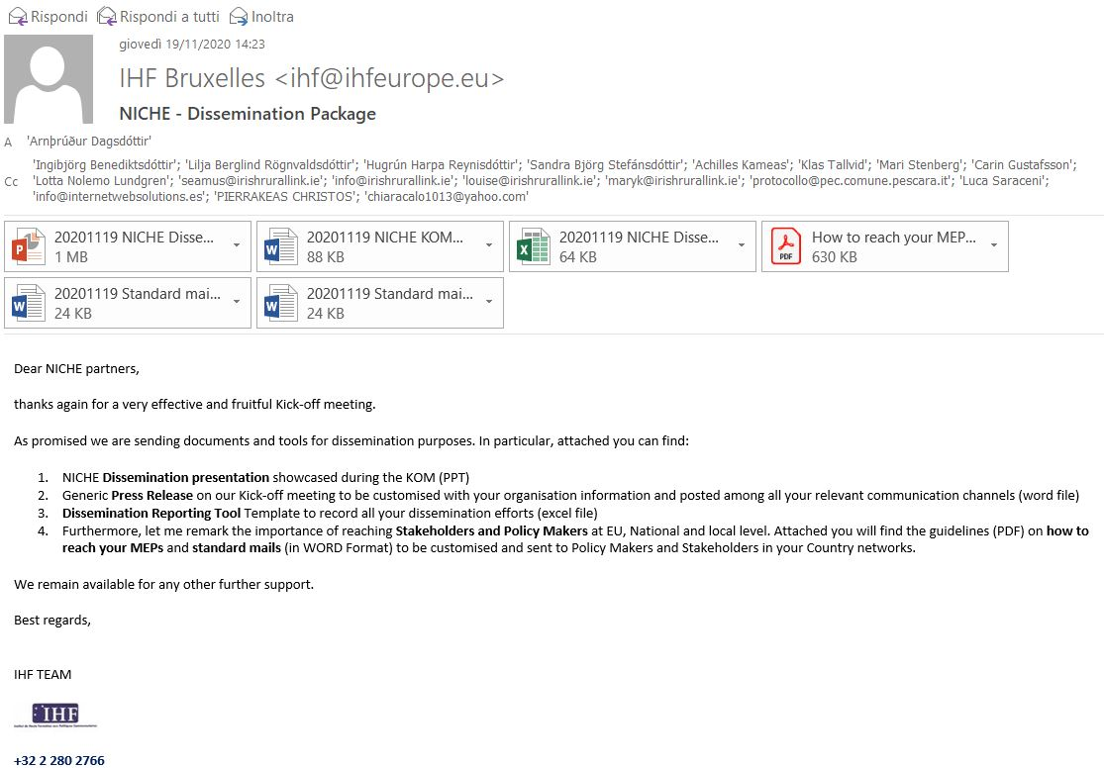
Unit 3
Section 5 – …VS a good email
The European Commission's support for the production of this publication does not constitute an endorsement of the contents, which reflect the views only of the authors, and the Commission cannot be held responsible for any use which may be made of the information contained therein.

Slide 24
EXTRA
How do you combine entrepreneurship with cultural heritage? Establishing a digital identity…
In the following slides, we will introduce readers to a good-practice scenario which demonstrates how entrepreneurs and organisation operating in the field of cultural heritage can formulate and design their (online) communication strategies and overall digital identity so as to better valorise their offer and their values – inspired by the promotion and safeguard of intangible cultural heritage.
Farmhouses in Europe represent a vibrant market industry with incredibly high potentials for the mainstreaming and showcases of local cultural heritage and agro-food traditions.
Their (online) communication is typically very appealing to the vast majority of online public and leverages on a sophisticated promotions of “immersive experiences”, rather than goods and/or services…
http://www.madonnadegliangeli.com/
The European Commission's support for the production of this publication does not constitute an endorsement of the contents, which reflect the views only of the authors, and the Commission cannot be held responsible for any use which may be made of the information contained therein.

Slide 25
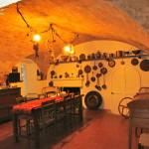
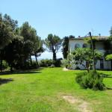
EXTRA
Lean, simple and user-friendly aesthetics
Madonna degli Angeli’s website fits this exact scope: the overall layout of the webpage welcomes users with an intuitive and warm layout.
From the very first glance, users can gain access to all information they need: form the accommodation facilities, to the environmental surroundings…
The European Commission's support for the production of this publication does not constitute an endorsement of the contents, which reflect the views only of the authors, and the Commission cannot be held responsible for any use which may be made of the information contained therein.

Slide 26
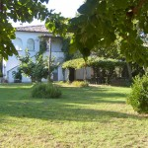
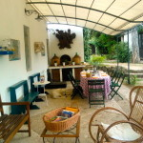
EXTRA
The “Experience” formula
A many other organisations and businesses operating in the field of cultural heritage, farmhouses are not limited to the self-perception of holiday resort, but as a suggestive and welcoming environments integrated within the landscape they contribute to define its traditional identity, helping people to rest from the tumultuous life of the cities, mostly spent at frenetic rhythms in indoors environments.
In this case, the (online) communication pillars exploits a sense of peacefulness so desperately seeked by the men and women “of the city”, alienated by their daily routines in between of traffic, meetings, and work appointments…
The European Commission's support for the production of this publication does not constitute an endorsement of the contents, which reflect the views only of the authors, and the Commission cannot be held responsible for any use which may be made of the information contained therein.

Slide 27
EXTRA
The power of storytelling
In order to obtain positive outcomes in reviews and customer loyalty, the role of cultural mediation played by the owner of the business was of fundamental importance, a person able to empathize with the guests by communicating both the authenticity of the story and the passion of those participating in it.
The accommodation phase is always contextualized in reference to the analogous vision of the territory, so as to build a unique “brand” defining them mutually.
Travellers are offered extremely varied integrated experiential itineraries, providing them an added value that characterizes the stay in the structure, inducing the tourist to stay for several days and not just on weekends.
The European Commission's support for the production of this publication does not constitute an endorsement of the contents, which reflect the views only of the authors, and the Commission cannot be held responsible for any use which may be made of the information contained therein.

Slide 28
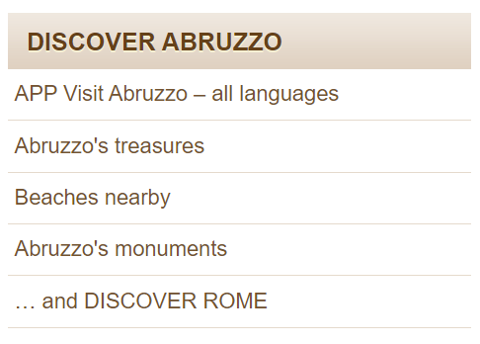
EXTRA
Lastly but not least
Is it common for farmhouses, and other business in the filed of ICH, nurture, strengthen and foster a local network of stakeholders and other sector operators that cross-promote their services and overall offer.
If the intention (i.e., objective) is to provide for client and customers a comprehensive experience, this must be as inclusive and diverse and possible, rooted in traditions and valorising of the best local territory has to offer
That way, ICH businesses contribute to generate an economic cycle from which they can all benefit from: business, people and local communities.
The European Commission's support for the production of this publication does not constitute an endorsement of the contents, which reflect the views only of the authors, and the Commission cannot be held responsible for any use which may be made of the information contained therein.

Slide 29
THANK YOU

