Slide 1
Working with ICH - Developing and valuing your ideas PARTNER: HAC

Slide 2
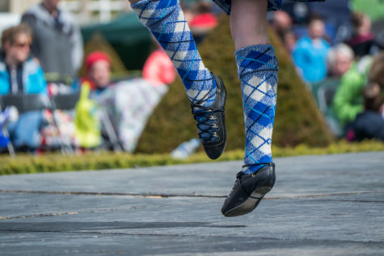
OBJECTIVES AND GOALS
At the end of this module you will be able to:
Understand what ICH is
The role of UNESCO and the different manifestation of ICH
Understand different ways to work with ICH
Professional or pastime and useful questions
Value your ICH idea
Generate ideas, improve and value them
The European Commission's support for the production of this publication does not constitute an endorsement of the contents, which reflect the views only of the authors, and the Commission cannot be held responsible for any use which may be made of the information contained therein.

Slide 3
INDEX
Unit 3
Unit 2
Valuing ideas.
Working with Intangible Cultural Heritage.
Unit 1
What is Intangible Cultural Heritage?

Slide 4
Unit I What is Intangible
Cultural Heritage?
Definitions of ICH
The role of UNESCO
5 ICH Domains
Cultural heritage and intangible cultural heritage
Interesting points of discussion on ICH
The European Commission's support for the production of this publication does not constitute an endorsement of the contents, which reflect the views only of the authors, and the Commission cannot be held responsible for any use which may be made of the information contained therein.

Slide 5
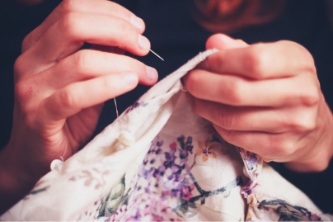
1.1. Definitions of ICH
“Intangible cultural heritage includes practices, presentation, expression, knowledge, skills – as well as tools, objects, artefacts and cultural spaces associated with them – that societies, groups and in some cases individuals consider to be their cultural heritage”
Definition of ICH from UNESCO

Slide 6
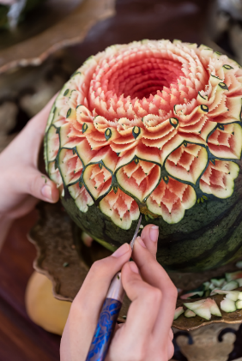
1.2. The role of UNESCO
“That since wars begin in the minds of men, it is in the minds of men that the defences of peace must be constructed; ”
UNESCO is the United Nations Educational, Scientific and Cultural Organization. It seeks to build peace through international cooperation in Education, the Sciences and Culture.
UNESCO has played a vital role worldwide in increasing people´s awareness of ICH.

Slide 7
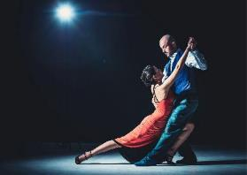
1.2. The role of UNESCO
Now over 180 STATES have ratified the UNESCO Convention for the Safeguarding of the Intangible Cultural Heritage from 2003.
The purposes of the 2003 Convention are:
to safeguard the intangible cultural heritage;
to ensure respect for the intangible cultural heritage of the communities, groups and individuals concerned;
to raise awareness at the local, national and international levels of the importance of the intangible cultural heritage, and of ensuring mutual appreciation thereof;
to provide for international cooperation and assistance.

Slide 8
1.2. The role of UNESCO
A part of the work of UNESCO in collaboration of the member states are done through the Convention Lists:
List of Intangible Cultural Heritage in Need of Urgent Safeguarding :
composed of intangible heritage elements that concerned communities and States Parties consider require urgent measures to keep them alive.
Representative List of the Intangible Cultural Heritage of Humanity:
made up of those intangible heritage elements that help demonstrate the diversity of this heritage and raise awareness about its importance.
Register of Good Safeguarding Practices:
contains programs, projects and activities that best reflect the principles and the objectives of the Convention.
1
2
3

Slide 9
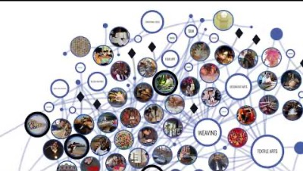
1.2. The role of UNESCO
The Official website of UNESCO on Intangible Cultural Heritage has information about the work of UNESCO but also gives the possibility to see the listed Intangible Heritage in a visual and interactive way: Dive into Intangible Cultural Heritage

Slide 10
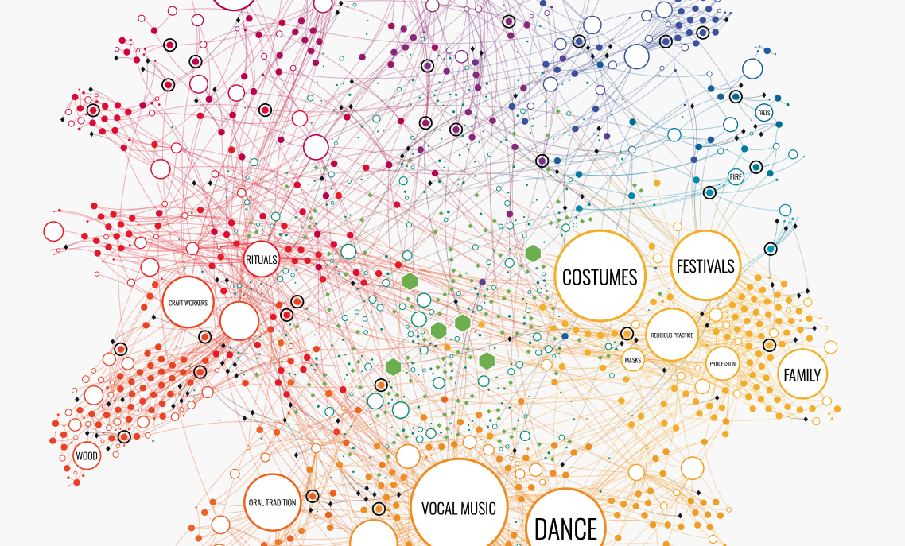

Slide 11
1.3. - 5 ICH Domains
The ‘Intangible Cultural Heritage’, as defined by UNESCO is manifested in the following domains:
(a) oral traditions and expressions, including language as a vehicle of the intangible cultural heritage
(b) performing arts
(c) social practices, rituals and festive events
(d) knowledge and practices concerning nature and the universe
(e) traditional craftsmanship

Slide 12
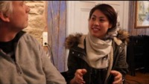
A. Oral Traditions And Expressions, Including Language As A Vehicle Of The Intangible Cultural Heritage
An enormous variety of spoken forms. Some are common and can be used by entire communities while others are limited to particular social groups,
Proverbs, riddles, tales, nursery rhymes, legends, myths, epic songs and poems, charms, prayers, chants, songs, dramatic performances and more
Oral traditions and expressions are used to pass on knowledge, cultural and social values and collective memory.
The European Commission's support for the production of this publication does not constitute an endorsement of the contents, which reflect the views only of the authors, and the Commission cannot be held responsible for any use which may be made of the information contained therein.

Slide 13
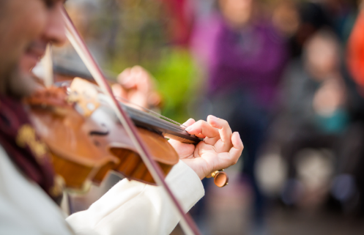
B. Performing Arts
This can include music, dance and theatre, pantomime, songs and other forms of artistic expression that are passed down from generation to generation.
They include numerous cultural expressions that reflect human creativity and that are also found, to some extent, in many other intangible cultural heritage domains.
The European Commission's support for the production of this publication does not constitute an endorsement of the contents, which reflect the views only of the authors, and the Commission cannot be held responsible for any use which may be made of the information contained therein.

Slide 14
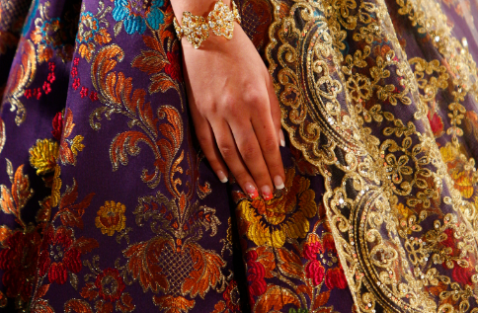
C. Social Practices, Rituals And Festive Events
Social practices, rituals and festive events are habitual activities that structure the lives of communities and groups and that are shared by and relevant to many of their members.
Rituals and festive events often take place at special times and places and remind a community of aspects of its worldview and history.
Social practices shape everyday life and are familiar to all members of the community, even if not everybody participates in them.
The European Commission's support for the production of this publication does not constitute an endorsement of the contents, which reflect the views only of the authors, and the Commission cannot be held responsible for any use which may be made of the information contained therein.

Slide 15
D. Knowledge And Practices Concerning Nature And The Universe
Knowledge, knowhow, skills, practices and representations developed by communities by interacting with the natural environment
Numerous areas such as traditional ecological wisdom, indigenous knowledge, knowledge about local fauna and flora, traditional healing systems, rituals, beliefs, initiatory rites, cosmologies, shamanism, possession rites, social organisations, festivals, languages and visual arts.
The European Commission's support for the production of this publication does not constitute an endorsement of the contents, which reflect the views only of the authors, and the Commission cannot be held responsible for any use which may be made of the information contained therein.

Slide 16
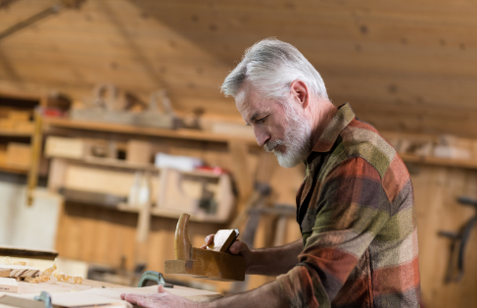
E. Traditional Craftsmanship
There are numerous expressions of traditional craftsmanship: tools; clothing and jewellery; costumes and props for festivals and performing arts; storage containers, objects used for storage, transport and shelter; decorative art and ritual objects; musical instruments and household utensils, and toys, both for amusement and education.
The skills involved in creating craft objects are as varied as the items themselves and range from delicate, detailed work such as producing paper votives to robust, rugged tasks like creating a sturdy basket or thick blanket.
The European Commission's support for the production of this publication does not constitute an endorsement of the contents, which reflect the views only of the authors, and the Commission cannot be held responsible for any use which may be made of the information contained therein.

Slide 17
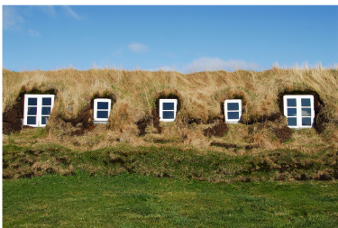
1.4. Cultural heritage and intangible cultural heritage
The concepts often go hand in hand. Intangible cultural heritage consists of traditions, knowledge and customs that are passed down from person to person and are often intertwined with the tangible cultural heritage such as monuments, costumes, tools, houses.
An example of this interplay are the Icelandic turf houses that are preserved by the National Museum of Iceland. The houses themselves are cultural heritage and the building technique, is intangible cultural heritage, skills that are learned from person to person.

Slide 18
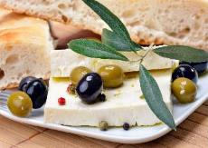
1.5. Interesting points of discussion on ICH
The concept of safeguarding ICH and the work of UNESCO is not above criticism and interesting discussions. Here are a few examples:
It is natural for culture to develop and change, does the safeguarding of ICH prohibit this?
If a custom/knowledge/skill needs safeguarding it does not have a role in the culture anymore, it is not sustainable.
What is considered important enough to be considered intangible heritage and who will decide this?
Does this discriminate between groups in the society?
Is some ICH better forgotten?
To document ICH is not the same as safeguarding it.
Who decides what is the right way to do things when working with ICH?
What about heritage that has been forgotten is it okey to revive it?
Is it possible to own ICH and then what does that mean?

Slide 19
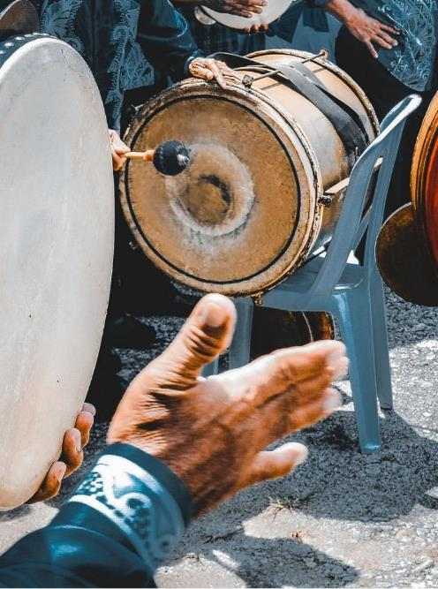
Unit II Working with Intangible Cultural Heritage.
ICH - professional and pastime
It´s alive
Where do we start?
ICH and Tourism
The European Commission's support for the production of this publication does not constitute an endorsement of the contents, which reflect the views only of the authors, and the Commission cannot be held responsible for any use which may be made of the information contained therein.

Slide 20
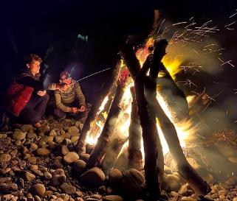
2.1. ICH – both professional and pastime activity
It can range from simple everyday traditions up to impressive advanced skills.
The skills and knowledge can be both used in the private life of individuals and publicly. It is both social and individual activity.
ICH can also be a part of other service, or the of making of a product.
ICH has often the potential to be a resource for community development.

Slide 21
2.2. It´s alive
When working with ICH the term ‘safeguarding’ is used. The emphasises that the idea is to protect elements of ICH, without seeking to freeze them in some pure or authentic form.
Intangible Cultural Heritage is kept alive and relevant when practised and shared.
ICH is ever changing and evolving – it is not an item in a museum to admire.
Every generation will influence it, both with small adjustments or major changes.

Slide 22
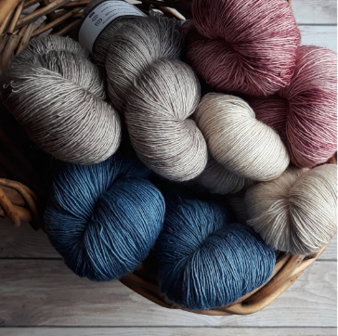
2.2. It´s alive
It is creative work but has its foundation in the knowledge that is passed down from generation to generation. Its safeguarding is based on the continuing activities of those with specific knowledge of traditions, skills and customs within communities.
This can be controversial. Many believe in doing things as they have always been done while other believe in more freedom in working with ICH.
Therefore both respect and openness can be an important part of working with ICH, for the past and for the diverse and vibrant culture of the present.

Slide 23
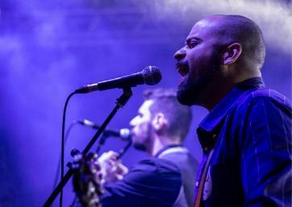
2.3. Where do we start?
Working with ICH gives the opportunity of verity of professions, part time as well as full time
If you are already working with ICH these questions could be relevant to you:
How can you develop your ideas further?
How can you support and encourage the passing on of knowledge and skills?
How can you reach people better, tell the story of your ICH?
How can you improve your service and product?

Slide 24
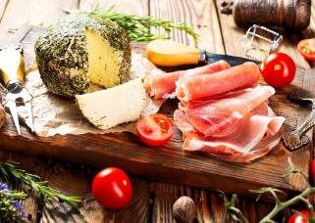
2.3. Where do we start?​
If you are interested in working with ICH:
Compile a list of traditions, knowledge and customs in your community.
Identify the tradition-bearers and elders in your area.
Think of how ICH can support your business idea.
Think of how if you would become good at it could give you an opportunity of a part time or full-time work.
Think of how it could give you an interesting pastime activity.
It is possible to work locally or internationally, across many disciplines.
Is documenting ICH in your community an interesting option?
What about celebrating ICH with festivals and commemorations?

Slide 25
2.4. ICH and Tourism
" Tourism is a genuine driver of solidarity and development. Let us all fully harness its power to bring people and communities together, abiding by the Global Code of Ethics for Tourism. This way tourism can keep delivering better opportunities and sustainable development for millions across the globe. "
Zurab Pololikashvili, UNWTO Secretary-General, August 2020
Tourism is an important option for many working with ICH. In the Global Code of Ethics for Tourism culture acknowledges this:
“Tourism policies and activities should be conducted with respect for the artistic, archaeological and cultural heritage, which they should protect and pass on to future generations...”
"Tourism should be organized in such a way as to enable traditional goods, handicrafts and cultural heritage to flourish, rather than to cause decline and lead to homogeneity”
(Article 4, paragraph 2, 4. UNWTO, 2017)
Notes:
https://www.unwto.org/global-code-of-ethics-for-tourism
UNWTO Framework Convention on Tourism Ethics

Slide 26
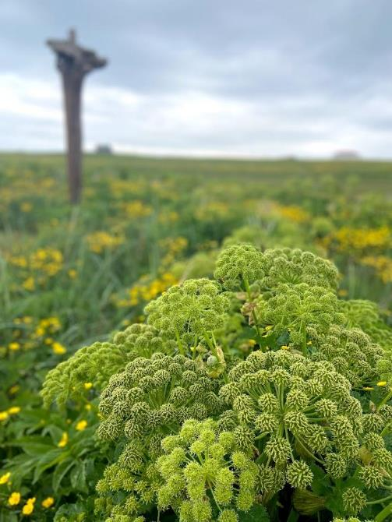
Unit III Valuing Ideas
Generating ideas
Ways to be more creative in your work with ICH
How to improve your ICH idea
How can an idea be ‘valuable’?
What is ‘value’ in social, cultural and economic terms?
The European Commission's support for the production of this publication does not constitute an endorsement of the contents, which reflect the views only of the authors, and the Commission cannot be held responsible for any use which may be made of the information contained therein.

Slide 27
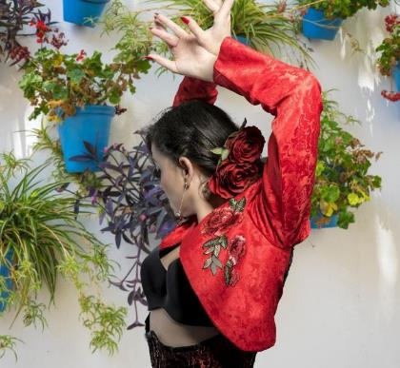
3.1. Generating ideas
When working with ICH generating ideas can be the first step in eventually picking and valuing a certain idea.
Developing creative thinking will help generate ideas of value.
"Creativity encompasses the ability to discover new and original ideas, connections, and solutions to problems. It’s a part of our drive as humans—fostering resilience, sparking joy, and providing opportunities for self-actualization. "

Slide 28
3.2. Ways to be more creative in your work with ICH
Make time for creativity and aim for output. Even if you do not feel inspired you have to continue working.
Play with prototypes​.
Keep learning.
Be open and playful.
Overcome your fear, failure is a part of creative work.
Find what works for you; listen to music​, take a walk​, get enough sleep ​etc.
Diverse feedback is very helpful , get others perspective.
Consider alternative scenarios.
Be on the lookout for opportunities and unexpected
connections.
Take a mental break to allow yourself to refocus.
​

Slide 29
“Creativity is inventing, experimenting, growing, taking risks, breaking rules, making mistakes, and having fun." -- Mary Lou Cook​
Associating
Making connections between problems or ideas from unrelated fields
Questioning
Asking questions that challenge common knowledge
Observing
Analyse customers, suppliers and competitor's behavior to identify new ways of doing things
Experimenting
Constructing interactive experiences and provoking unorthodox
responses to see what insights emerge

Slide 30
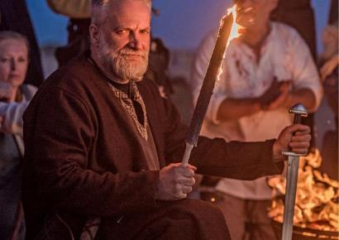
3.3. How to improve your ICH idea
Entrepreneurs working with ICH use many ways to spark their creativity.
It´s important to find whatever works for you and use it to strengthen your work
"Creativity doesn't wait for that perfect moment. It fashions its own perfect moments out of ordinary ones." - Bruce Garrabrandt

Slide 31
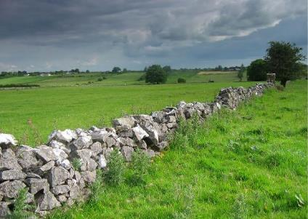
3.3.1. Systematic Inventive Thinking ​​
Systematic inventive thinking is a technique to create new solutions by looking at an idea or a product from different perspectives​​
A part of it is the The Five Thinking Tools method​​:
Subtraction​
Multiplication​
Division​
Task Unification​
Attribute Dependency​

Slide 32
Subtraction​
Remove an essential component from a product / idea and find uses for the newly envisioned arrangement of the existing components.​​
Example: ​​
Removing the ear covers from
traditional headphones resulted
in “ear buds” that fits inside the ear.​​
Multiplication​
Add to a product / idea a component of the same type as an existing component. The added component should be changed in some way.​​
Example:​​
Training wheels for children's bicycles.
Wheels duplicated and modified to
create a new product.​
​

Slide 33
Division
Divide the product / idea functionally or physically and then readjust it. Taking a full-sized product and dividing it into smaller versions of itself. ​​
Example:​​
For example, cupcakes are smaller individual sized cakes.​​
Task Unification​​
Assign a new and additional task to an existing resource. The task may be previously thought to be unrelated. ​​
Example:​​
A Facial moisturizer can additionally provide sunscreen protection.​​

Slide 34
Attribute Dependency​
Creating and breaking dependencies between variables of a product. As one attribute changes another does too.​​
Example:​​
Transition sunglasses which get darker as the outside light gets brighter.​​

Slide 35
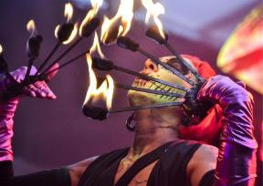
3.3.2. Design thinking​
Design thinking is a process for creative problem solving.​ It is a way to value and improve your ideas.
It is human- centered, it puts the focus on the people the product or service is being made for. It asks the question What is the human need behind it?​
It uses empathy and looks at how consumers engage with a product or service. This is in preference to how you or someone else believes they will engage with it.​
It favors moving quickly to get prototypes out to test rather than brainstorm or long research. The product or service is then refined to fit the need of the consumer.​

Slide 36
Design Thinking is not a linear process but there are 5 stages: ​
Stage 1: Empathize
Research Your Users' Needs​
Use your empathy to understand users needs
Gain real insight
Forget your assumptions
Stage 2: Define
State Your Users' Needs and Problems
Gather all the information
Analyze your observations and find out what are the core problems
You can create personas to help keep your efforts human-centered before proceeding to ideation.​​
Stage 3: Ideate
Challenge Assumptions and Create Ideas​
Generate ideas
Look for alternative ways to view the problem
Identify innovative solutions

Slide 37
Stage 5: Test
Try Your Solutions Out:
Test the prototypes
Refine
You can also return to previous stages to make further iterations, alterations and refinements
Stage 4: Prototype
Start to Create Solutions
The experimental phase
Identify the best possible solution
Make simple, inexpensive prototypes
Stage 5: Test
Try Your Solutions Out:
Test the prototypes
Refine
You can also return to previous stages to make further iterations, alterations and refinements
Stage 4: Prototype
Start to Create Solutions
The experimental phase
Identify the best possible solution
Make simple, inexpensive prototypes
​

Slide 38
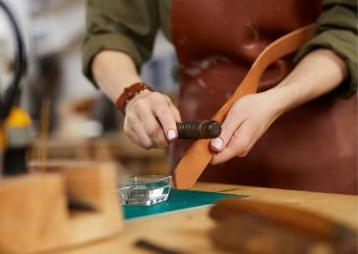
3.4. How can an idea be ‘valuable’?
Value is what is valuable to one person, may not be valuable to another person.
Value depends on the time and place.
We evaluate the ICH idea in context.
Consider the social, cultural and economic value of your ICH idea.
When working with your ICH idea you could ask questions such as:
Is this idea of value to me?
Does this idea have a market?
Does this idea solve a social problem?
Could this idea create profit?
Is this idea needed right now?
What are the strengths/ weaknesses of the idea?

Slide 39
3.4.1. Does your idea have cultural value?
Fun
Personal and collective wellbeing
Supports resilience
Brings us beyond words
Transcends barriers of language, time, and generation
Skills and knowledge
Opens the mind and heart
Stimulates and motivates
Instills curiosity
Empathy
Nurtures confidence
Alternative ways of thinking
The European Commission's support for the production of this publication does not constitute an endorsement of the contents, which reflect the views only of the authors, and the Commission cannot be held responsible for any use which may be made of the information contained therein.

Slide 40
3.4.2. Does your idea have social value?
Culture of innovation
Bringing people together
Community
engagement
Empowerment
Social cohesion
Sense of place
Informed citizen
Long-term wellbeing and resilience of individuals
Social network
Solve a social problem
Understanding and drawing on the past
The European Commission's support for the production of this publication does not constitute an endorsement of the contents, which reflect the views only of the authors, and the Commission cannot be held responsible for any use which may be made of the information contained therein.

Slide 41
3.4.3. Does your idea have economic value?
Employment outcomes
An idea that has a market
Stimulating local economies
Attracting investments
Supports other businesses such as tourism
Financially sustainable
Culture of innovation
Generating tax revenues
Could create profit
The European Commission's support for the production of this publication does not constitute an endorsement of the contents, which reflect the views only of the authors, and the Commission cannot be held responsible for any use which may be made of the information contained therein.

Slide 42
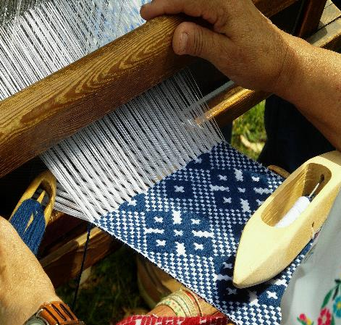
Self-assessment test
1. When working with ICH :
UNESCO has played a vital role worldwide in increasing people‘s awareness of ICH.
It is always clear weather things are intangible or tangible heritage.
People agree on how it is best to do it.
3. When working with ICH it is important to:
Never do anything new.
Never to change anything.
Respect the heritage but be creative.
2. Value of an idea is:
Depending on the time and place.
Always fixed.
Only economic.
The European Commission's support for the production of this publication does not constitute an endorsement of the contents, which reflect the views only of the authors, and the Commission cannot be held responsible for any use which may be made of the information contained therein.

Slide 43
Self-assessment test
4. Design thinking is:
a way to make things look better
a method to think more positive
a process for creative problem solving
The European Commission's support for the production of this publication does not constitute an endorsement of the contents, which reflect the views only of the authors, and the Commission cannot be held responsible for any use which may be made of the information contained therein.

Slide 44
Summing Up
ICH includes e.g., practices, presentation, expression, knowledge, skills
ICH – both professional and pastime activity
It can also be the tools, objects, artefacts and cultural spaces associated with them.
Intangible Cultural Heritage is kept alive and relevant when practised and shared
Every generation will influence it, both with small adjustments or major changes.
The ‘Intangible Cultural Heritage’, as defined by UNESCO is manifested in five domains:
Entrepreneurs working with ICH use many ways to spark their creativity.
(a) oral traditions and expressions
(b) performing arts
(c) social practices, rituals and festive events
(d) knowledge and practices concerning nature and the universe
(e) traditional craftsmanship
Generate ideas, work on improving them and consider the social, cultural and economic value of your ICH idea

Slide 45
THANK YOU

