Slide 1
KEY PRINCIPLES OF ICH SAFEGUARDING PARTNER: IWS

Slide 2
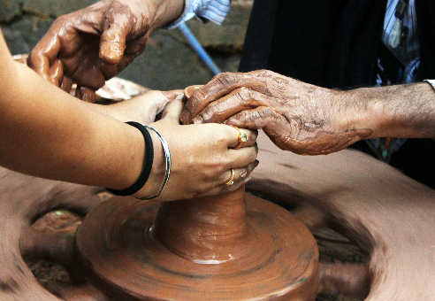
GOALS
To use ICT Tools for ICH dissemination on the Internet and to enhance online skills among entrepreneurs in the Intangible Cultural Heritage Sector.
The European Commission's support for the production of this publication does not constitute an endorsement of the contents, which reflect the views only of the authors, and the Commission cannot be held responsible for any use which may be made of the information contained therein.

Slide 3
INDEX
1.1: Benefits of using ICT tools for ICH safeguarding
2.1: The Cloud and ICH
Unit 1: Use of ICTs for the safeguarding of ICH.
Unit 2: Cloud sharing to transfer and safeguard ICH.
1.2: ICH information sharing multimedia options
1.3: Tips for ICH dissemination online
2.2: ICT Tools for cloud sharing

Slide 4
KEY PRINCIPLES OF ICH SAFEGUARDING
Intangible Cultural Heritage’s inmaterial nature makes it difficult to preserve, but the online world and ICT tools can help provide useful platforms and methods to spread its valuable influence.
We must bear in mind that ICH importance is not about the cultural manifestations themselves, but the knowledge and abilities transmitted from one generation to another.
This heritage is fragile and its influence could be easily lost over the years with the increasing globalization and market competence. Hence the importance of its preservation.

Slide 5
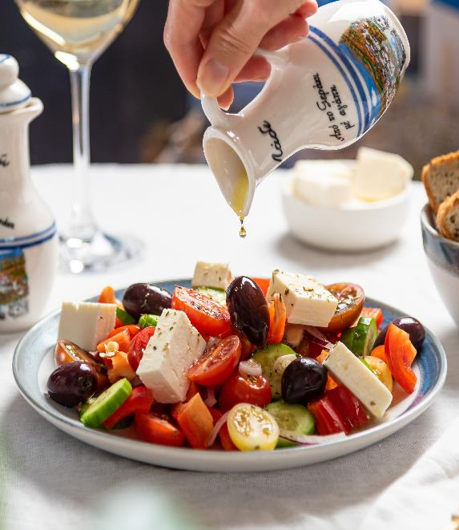
Unit 1: Use of ICTs for the safeguarding of ICH.
The main way of preserving ICH is making it known among different countries and generations. The online world is a network that connects millions of people, making it a great medium for ICH dissemination.
The European Commission's support for the production of this publication does not constitute an endorsement of the contents, which reflect the views only of the authors, and the Commission cannot be held responsible for any use which may be made of the information contained therein.

Slide 6
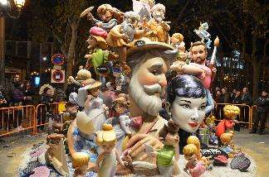
1.1: Benefits of using ICT tools for ICH safeguarding
ICT tools –which stands for“Information and Communication Technology”—are a series of platforms, resources and devices that can transfer any type of information. This is why they play an important role on ICH safeguarding.
As we have said before, the online world offers endless opportunities for sharing and saving information. In the following slides, some of the benefits of using ICT tools for ICH preservation will be presented:

Slide 7
1.1: Benefits of using ICT tools for ICH safeguarding
Non-deteriorating nature. Just as ICH, the online world is intangible. This allows to store information that does not deteriorate, unlike paper documents. Plus, is almost impossible that this information disappears, as it is stored in the “Cloud”.
Accessible. The Internet offers a great medium for data, information and file sharing, making it easier to spread the influence of Cultural Heritage.
In addition, we can share our own materials or allow users to add theirs, which after being approved, can help increase the amount of information, testimonies and multimedia files, as well as updated news.

Slide 8
1.1: Benefits of using ICT tools for ICH safeguarding
Updatable and reviewable. As we have said, everyone can access Cultural Heritage resources on the Internet and learn about them. This also includes constant revision, both by users and experts. This means this information can be updated, fixed and extended in a matter of seconds by people in every country.
Nevertheless, we must be careful as users may add fake or doubtful information. Therefore, we must constantly review and delete these, or only allow to add information to authorized users.

Slide 9
1.2: ICH information sharing multimedia options
ICH has different types of manifestation, and its diversity may cause some problems when it comes to spread and make its legacy known. To ensure it, we can use different types of files depending on the type of ICH we want to preserve. In this section, we provide multimedia options for information sharing and online platforms for each one.

Slide 10
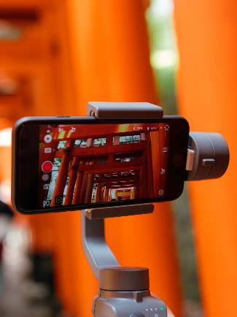
1.2: ICH information sharing multimedia options
Videos: Videos are a great option for dynamic interaction. They allow to share traditional dances, ceremonies or even testimonies and interviews, making it more entertaining and graphic for people to understand and learn.
There are many platforms for video sharing, but the one par excellence is YouTube, used by millions of users worldwide, hosting videos on any subject. Furthermore, it offers a subscription and opinion systems that allows interested people to know when new content is uploaded in your channel.
Another option is Vimeo. This platform is not as popular as YouTube, but offers a great visual quality, which is very important for ICH communication.

Slide 11
1.2: ICH information sharing multimedia options
Images: a great option for transmitting first hand visual experiences. This way, people can see important cultural heritage elements that otherwise they would never get to see. This way, this intangible heritage can be immortalised and passed on for generations.
Instagram is one of the main image and short video platforms. Very popular among young users, this social media is great for educational purposes.
Pinterest allows users to “pin” their interests on virtual boards. This way other users can see your boards, take ideas and find new interesting content.

Slide 12
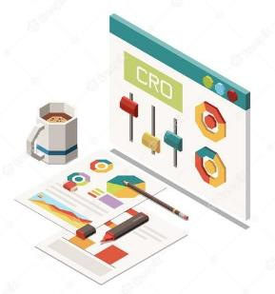
1.2: ICH information sharing multimedia options
Information, newsletters and documents: Information is a key factor for ICH transmission, and the Internet allows to spread this information around the world. Making ICH known guarantees its safeguarding and legacy. Therefore, a good information organisation and dissemination system can be very helpful.
As we have seen in the previous section, the Internet is constantly being updated and expanded. ICH is always an interesting topic; new users discover different websites and platforms, which mean that news, photographs and information are added to them periodically.

Slide 13
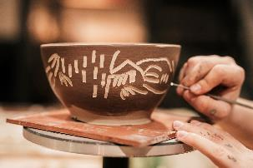
1.2: ICH information sharing multimedia options
A very useful tool for Intangible Cultural Heritage dissemination are websites, which offer a centralised platform that makes accessing information and media easy and available in a few clicks. It is key to have a website for our project, aside from any external social media or platform. This will attract more users and will enhance our strategy and statistics.

Slide 14
1.3: Tips for ICH dissemination online
As we have seen, ICT tools offer a great opportunity for cultural information dissemination. Nevertheless, a good organisation and strategy are necessary for our project to succeed. Here we present some tips for a good ICH project dissemination:
Website organisation: A good website organisation is a key factor in our strategy. Make sure all the contents are accessible in a few clicks, and that the most interesting pages are easier to find, as this will attract more users. Arrange the contents coherently and intuitively.

Slide 15
1.3: Tips for ICH dissemination online
Networking strategy: Social media are a great opportunity to make yourself known. They are a dynamic way to contact people and interact with them, as well as to know potential partners and references. Make your project known and create a follower community. As we have seen in previous sections, there are different social media with different purposes. Choose the ones that suit you better and design, schedule and publish content for your networking campaign.

Slide 16
1.3: Tips for ICH dissemination online
Multimedia content: When it comes to ICH dissemination, audiovisual content is essential. Bear in mind that many of these cultural traditions or elements are better understood with visual support (for example, Spanish ‘Flamenco’ dance videos). Therefore, including these multimedia elements will attract interest to your project. Nevertheless, we must assure videos and images have good quality; otherwise, the user’s experience will not be enjoyable.
Language options: Our goal is to reach as many users as possible. A website with multiple language options can bring more people from different countries to know your ICH project.
Subscription and Newsletters: Subscription options help keep users updated and informed (if required). Sending newsletters to subscribers allows to keep them interested and can bring new users to our website.

Slide 17
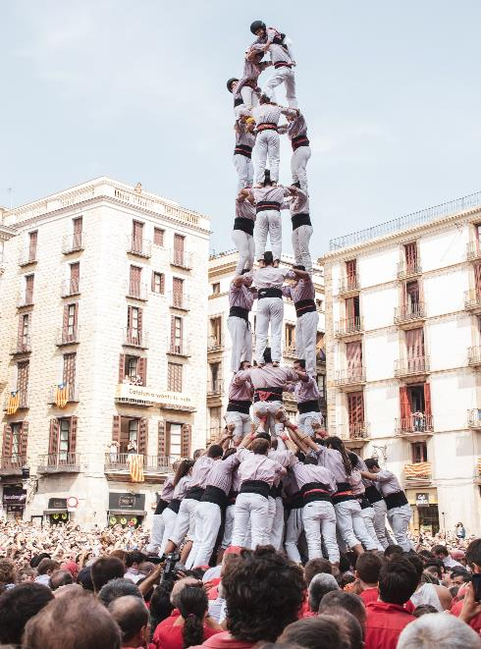
Unit 2: Cloud sharing to transfer and safeguard ICH.
The European Commission's support for the production of this publication does not constitute an endorsement of the contents, which reflect the views only of the authors, and the Commission cannot be held responsible for any use which may be made of the information contained therein.

Slide 18
2.1: The Cloud and ICH
The Cloud is an online server hosting service that allows to upload, store, share or modify multimedia files. This way, it is not necessary an external hard drive to store our information.
Furthermore, this data is accessible by authorized users from any device or country, allowing complete versatility. Plus, the Cloud guarantees secure file storing. A hard drive can deteriorate or be lost, and occupies a significant physical space. The Cloud is a virtual server’s system that can store several amounts of multimedia elements without occupying physical space for the user.
You can use the Cloud to share, transfer and store different types of files and data, being a key part of your ICH project.

Slide 19
2.2: ICT Tools for cloud sharing
There are many applications, webs and platforms that offer a file hosting service, with free and premium options. We present some of the most relevant tools for cloud storing and their main features, so you can choose the those that best suit your project:
Dropbox: This tool offers online synchronization thanks to an online server. Its free option offers a file storage of up to 10 GB.
WeTransfer: this app is specially designed for file transfer. It is easy to use and effective, and does not require to create an account to use it. You can upload up to 2GB for free, or use their payment services.

Slide 20
2.2: ICT Tools for cloud sharing
Google Drive: This Google service allows to upload different types of files in a virtual hard drive, with full integration with all Google services. Its free option allows to store up to 15 GB, and to edit them or download them online.
OneDrive: Micorsoft’s service that connects you with all your files. It allows to store, share, protect and access them from any device. Its free services include up to 5 GB and full integration with other Microsoft products.
Mega: This versatile platform that allows to share films, books, games, music, personal documents, images... in a safe way for the users and the platform, with up to 20GB of storage space in its free version.

Slide 21
SELF-ASSESSMENT TEST
1. Which one is an image-centered Social Media?
2. Which tip is recommended for online ICH dissemination?
3. Which of those truly helps spread ICH online?
Instagram
Twitter
YouTube
An attractive brand.
An effective networking strategy.
Creating many accounts in different platforms.
Having a laptop
Good multimedia content
Good typewriting
4. Which kind of storing space does the Cloud work with?
5. Which one is a Cloud file transfer platform?
Facebook
WordPress
OneDrive
Online
Offline
Physical
The European Commission's support for the production of this publication does not constitute an endorsement of the contents, which reflect the views only of the authors, and the Commission cannot be held responsible for any use which may be made of the information contained therein.

Slide 22
SELF-ASSESSMENT TEST
1. Which one is an image-centered Social Media?
2. Which tip is recommended for online ICH dissemination?
3. Which of those truly helps spread ICH online?
Instagram
Twitter
YouTube
An attractive brand.
An effective networking strategy.
Creating many accounts in different platforms.
Having a laptop
Good multimedia content
Good typewriting
4. Which kind of storing space does the Cloud work with?
5. Which one is a Cloud file transfer platform?
Facebook
WordPress
OneDrive
Online
Offline
Physical
The European Commission's support for the production of this publication does not constitute an endorsement of the contents, which reflect the views only of the authors, and the Commission cannot be held responsible for any use which may be made of the information contained therein.

Slide 23
SUMMING UP
Design a good website. This includes a good content organisation, publication strategy, user experience and positioning strategy.
Upload new contents to your webpage periodically and make sure your subscribers can know when you publish new contents
Create an account in a Cloud transfer platform and store different files for its storage and dissemination.
Choose the right social media for your project depending on the features and users.
Create a networking and positioning strategy on different social media.
Make sure your users have a grateful experience.

Slide 24
THANK YOU

