Slide 1
IMPLEMENTATION PARTNER: HEA

Slide 2
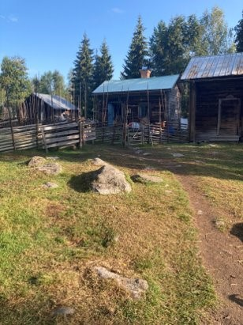
Goals
At the end of this module you will be able to:
Set goals
Set long-, medium- and short term goals
Management
Define priorities and form action plans
Follow-up
Follow-up and adapt to unforeseen changes
The European Commission's support for the production of this publication does not constitute an endorsement of the contents, which reflect the views only of the authors, and the Commission cannot be held responsible for any use which may be made of the information contained therein.

Slide 3
Index
2.1
Define priorities and action plans
1.1
Be Specific
Unit 1
Set goals
Unit 2
Management and Follow-Up
2.2
Adapt to unforeseen changes
1.2
Framework
1.3
Be Realistic
2.3
Tools

Slide 4
Unit 1 Set Goals
1.1 Be Specific
1.2 Framework
1.3 Be Realistic
The European Commission's support for the production of this publication does not constitute an endorsement of the contents, which reflect the views only of the authors, and the Commission cannot be held responsible for any use which may be made of the information contained therein.

Slide 5
1.1 Be Specific
Your goals must be clear, i.e. try to avoid words like “more”, instead use specific numbers.
Also set up sub targets, i.e. short- and medium-term goals to achieve on your way to your long-term goal.

Slide 6
1.1 Be Specific
1.1 Be Specific
Be specific when your goals will be achieved so that you have something clear and visible to work towards. It is important to focus on what is important.
Your goals should be challengeable, thus be inspiring which will give you energy, orientation and consensus. If goals are too hard or impossible to reach, there could be both stress and resignation. So be careful with your goals.

Slide 7
1.1 Be Specific
Set up sub targets, i.e. short- and medium-term goals to achieve on your way to your long-term goal.​ The long-term goal is the final step, when your business is up and going. How long that will take, of course, depends on what kind of business you have started.
​
A goal is not just only what you are supposed to earn or how much to sell, it is also how to work sustainable, about marketing and to create a good working environment.

Slide 8
1.1 Be Specific
Short- and medium-term goals are check-points supporting your long-term goal, for instance it could be when to introduce different aspects in your business. ​
All the goals should complement the others, short- and medium-term goals should thus support the long-term goal.
Each goal short-term, medium-term or long-term are thus important. One way to keep your spirits up is to think through and write down what will happen when each goal is achieved.

Slide 9
1.2 Framework
Your goals should be measurable, so that you in an easy way can see when you have achieved each and every goal.
1.1 Be Specific
1.3 Be Realistic

Slide 10
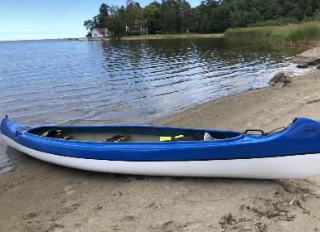
1.2 Framework
Make sure that everyone in the business understands all the goals.
Decide who will be responsible for each task. As far as possible try to let people with the best competence and interest in the area be the one responsible.

Slide 11
1.2 Framework
What competences are you in need of?​​
Create a net-work with people with the competences you need. First look within your business. Are there already people within your organization that have these competences? If not, whom do either one of you have in your circle of acquaintances? ​​
​​
Make a list of everyone that could be possible partners in your net-work. ​​
Contact everyone​​
Build a digital net-work​​
​​
​

Slide 12
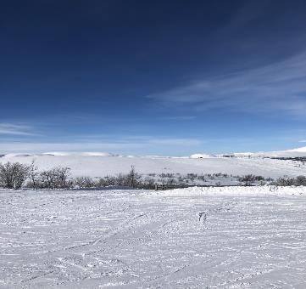
1.3 Be Realistic
Set goals that are achievable.
Try to predict any possible obstacles to prevent you from achieving your goals and how to concur them.
1.1 Be Specific

Slide 13
1.3 Be Realistic
1.3 Be Realistic
Set goals that are achievable.
Try to predict any possible obstacles to prevent you from achieving your goals and how to concur them.
The goals should be challenging, inspiring and realistic.
Goals will make things happen, nevertheless if one experience the goals too unachievable it risks to hinder the progress. This kind of goals could create both stress and resignation.
That is why the short- and medium-term goals are important as well because those will help to maintain inspired and focused, so that you could reach your long-term goals.

Slide 14
Unit 2 Management & Follow-Up
2.1 Define priorities and action plans
2.2 Adapt to unforeseen changes
The European Commission's support for the production of this publication does not constitute an endorsement of the contents, which reflect the views only of the authors, and the Commission cannot be held responsible for any use which may be made of the information contained therein.

Slide 15
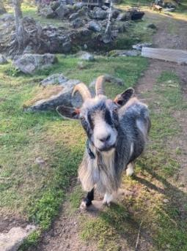
2.1 Define priorities and
action plans ​
Together make an action plan - discuss, note, keep focus and question. If something new turns up – add it to the list immediately.
Set time-limits. Predict and decide how much time each task could make use of.
Look it through. What is most important to do? What could be saved for later? Priorities and question. There will always be much you could do. But what is most urgent?

Slide 16
2.1 Define priorities and action plans
Now make a schedule, when to do what, i.e. in which order you will implement each task.
To make schedules there are different tools on the Internet that you can use to structure in a good way, e.g. Gantt.
A Gantt chart is a tool that can help you define, priorities and plan your actions. It is a graphic illistration of how planned activities are timely structured.
It is of great importance that you stick to the plan.

Slide 17
2.2 Adapt to
unforeseen changes
EVALUATE continually
When planning time also plan when to evaluate, maybe in the middle of each task.
To make this easy, be sure that each and everyone documents thoroughly during the process and saves all information. Make this a routine. This routine is necessary:
To get current information
To see what has happened
That will give you a chance to adapt to any unforeseen changes and make necessary reconstructions.

Slide 18
2.3 Tools
There are many different tools on the Internet which could help you structure the implementation of your business
GANTT
Gantt is a chart where you can structure your activities in time
SMART
Specific Measurable Achivable Relevant and Time bound = SMART is a tool for setting goals.
SWOT
Strengths Weaknesses Opportunities and Threats = SWOT is a tool you could use to find the above on different levels in your organization.

Slide 19
Self-Assessment Test
Your goals should be…
Is it important to set time-limits?
How often do you need to evaluate?
Specific
Measurable
Achievable
All of the above
Yes
No
In the end
Continually
In the beginning
What is the next step after evaluating?
What is SMART?
A tool for setting goals
A tool to structure your activities in time
A financial tool
Give up
Continue as before
Make necessary changes
The European Commission's support for the production of this publication does not constitute an endorsement of the contents, which reflect the views only of the authors, and the Commission cannot be held responsible for any use which may be made of the information contained therein.

Slide 20
Self-Assessment Test
Your goals should be…
Is it important to set time-limits?
How often do you need to evaluate?
Specific
Measurable
Achievable
All of the above
Yes
No
In the end
Continually
In the beginning
What is the next step after evaluating?
What is SMART?
A tool for setting goals
A tool to structure your activities in time
A financial tool
Give up
Continue as before
Make necessary changes
The European Commission's support for the production of this publication does not constitute an endorsement of the contents, which reflect the views only of the authors, and the Commission cannot be held responsible for any use which may be made of the information contained therein.

Slide 21
Summing Up
Evaluate
Goals
Set clear, measurable achieveable goals
Continually – during and after each task
Frames
Adapt to Changes
Be clear with what to do, in which order and by whom.
Make necessary changes and continue with your new knowledge.
Establish a timeline
Tools
How long will each task take and when will each task be done?
.
Ex. of tools to use: SMART, GANNT, SWOT

Slide 22
THANK YOU

