Slide 1
COMMUNICATION AND KNOWLEDGE TRANSFER
PARTNER: IWS

Slide 2
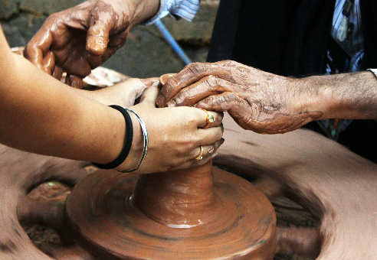
GOALS
To efficiently use ICTs for communication and knowledge transfer in the field of Intangible Cultural Heritage.
The European Commission's support for the production of this publication does not constitute an endorsement of the contents, which reflect the views only of the authors, and the Commission cannot be held responsible for any use which may be made of the information contained therein.

Slide 3
INDEX
1.1: Website design and creation.
2.1: Social media
Unit 1. Online communication, digital marketing and branding.
Unit 2: Social networks management: Tips for ICH knowledge transfer.
1.2: Digital marketing and branding
2.2: Netiquette

Slide 4
COMMUNICATION & KNOWLEDGE TRANSFER
The conservation and safeguarding of Intangible Cultural Heritage (ICH) are some of the main objectives of the European Union in the field of culture. Even though its intangible nature makes it difficult to preserve it, the UNESCO Convention for the Safeguarding of the Intangible Cultural Heritage (2003) foresees several actions to achieve this goal. These include research and adequate documentation of the heritage, including the cataloguing and digitization of photographic records and the creation of sound and audio-visual material and archives.
The ICH Safeguarding Plans of the different member states also include communication strategies as one of the main lines of action for the conservation and transmission of knowledge and heritage. In this sense, the Internet, social networks and all existing digital tools play a very important role in the conservation, promotion, recreation and dissemination of ICH.

Slide 5
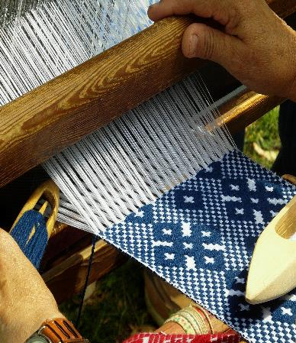
Unit 1. Online communication, digital marketing and branding.
The power and possibilities offered by the Internet are innumerable. Therefore, it becomes one of the most appropriate options for the safeguarding of ICH.
In this module, we will give you tips on how to effectively use the internet and digital resources to foster and promote ICH.
The European Commission's support for the production of this publication does not constitute an endorsement of the contents, which reflect the views only of the authors, and the Commission cannot be held responsible for any use which may be made of the information contained therein.

Slide 6
1.1: Website design and creation.
The creation of a website is one of the best options to communicate online with people from anywhere in the world. Therefore, it should be used as a method of transmission of intangible culture to promote and preserve traditional knowledge, crafts, customs, etc.

Slide 7
1.1: Website design and creation.
Nowadays, we can create our own website without the need of having any computer or programming knowledge. There are different platforms that offer pre-designed templates that will allow you to create a website according to your needs and objectives. However, you must pay attention and define some details before creating it.
It is important to define your objectives, the type of audience you are targeting and adapt the content, language and design to the type of audience.
To do this, you should take care of the language used (not to be too technical) and the information should be clear and concise, written in short paragraphs and with a font type and size appropriate to the content and the audience for which it is presented.
Bearing in mind that we are transmitting ICH, images play a very important role.
They should be attractive, descriptive and enlightening and in high resolution quality.

Slide 8
1.1: Website design and creation.
Another aspect to take into account is the optimization and positioning of your website in search engines. It is useless to have a creative, eye-catching and professional website if nobody visits it because it does not appear in the main search engines.
To improve the positioning and visibility online, you will have to take into account the SEO (Search Engine Optimization) of your web page, namely the content and keywords, as well as the quality of the links and the download speed of the website.

Slide 9
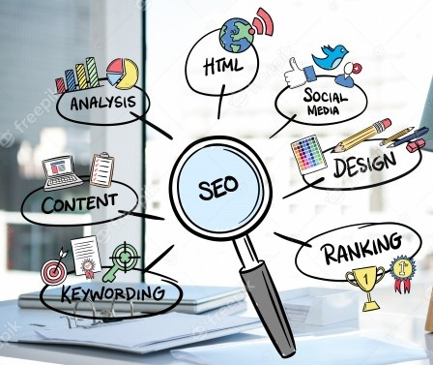
1.1: Website design and creation.
The keywords will be the ones that consumers of intangible culture will enter into Internet search engines to get the information they need. That is why it is important to analyse which are the most appropriate keywords, which you should use as many times as you can in the content of your website, but always in a coherent way and without being too repetitive. You should also make sure that your website has a Responsive design, that is, that it can be viewed from any digital device (computer, smart phone, tablet, etc).

Slide 10
1.1: Website design and creation.
These are some of the platforms you can use to create your own website:
These are just some of the options, although there are many more like Site123 or JIMDO. You can also find free and paid plans; the important thing is to do some research and find the platform that best suits and meets your needs and those of your target audience.
WordPress. This platform allows you to create blogs, websites, or online businesses for free. It is one of the most used and you can benefit from different templates that will give your website the design and look that best suits your needs.
Wix. With Wix you can create your website in a simple and intuitive way and you can choose from more than 500 predesigned templates, which you can easily customise to suit your audience, your goals and needs.
Squarespace. You can design your own website and choose from designs that will give it a very professional appearance.

Slide 11
1.2: Digital marketing and branding
When you venture into the digital world, you need to adopt a digital marketing strategy to get the most out of your website, and for this, there are different tools developed by experts that will allow you to
This will allow you to consolidate your brand, the image and identity of your company (branding), which can be known beyond the physical limits of space.
increase your chances
reach a wider audience
turning users and people who visit your website into potential customers or consumers of culture.

Slide 12
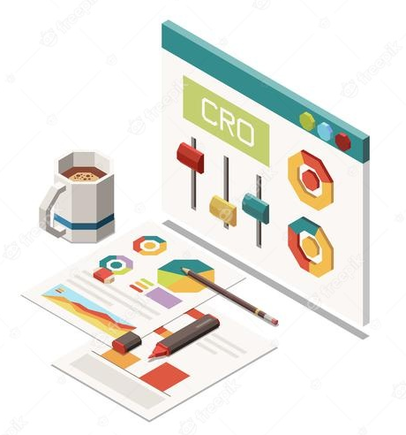
1.2: Digital marketing and branding
Obviously, before entering the digital world you need to establish and define well the identity and corporate image of your company, the name of your brand and the product or service you offer, you need a branding strategy.
Branding is the process of building and creating your brand and through it, you can convey the intangible values of your company, your services or products, ideas, feelings and sensations that will make your brand different from all others and so, it will be easily recognised among the public and consumers.

Slide 13
1.2: Digital marketing and branding
The aspects you must take into account to build your branding are:
the name
the logo
the symbols and values you want to transmit
the slogan and the domain of your website
You should try to take care of all these details, study them and even ask and show them to family and friends, in order to have different opinions and a broader vision of the image projected by your brand and how others perceive it.

Slide 14
1.2: Digital marketing and branding
However, branding does not end with its creation.
The image and identity of your company is something you must constantly take care of, create and maintain a good reputation, as well as carefully treat the data and information you transmit or share through digital media.
When you show your identity or create profiles through different digital media or social networks, you must do it responsibly and always maximise security measures when surfing the Internet. Try to keep both your operating system and your antivirus updated and frequently review the privacy and security options of the digital profiles you manage. A company's reputation is something that takes a lot of time and effort to create, but can be lost in the blink of an eye.

Slide 15
1.2: Digital marketing and branding
Once you have defined all these elements, you can start your marketing strategy and make your brand known through the digital environment.
Digital marketing covers many fields, but in this module, we will focus on SEO, email marketing and social media strategies. Here are some tools you can use to start your digital marketing strategy:
Social networks are another powerful tool that will help you promote and preserve ICH. In the next unit we will show you how to do it.
Semrush. This tool allows us to analyse the keywords and positioning of our website and that of our competitors. In this way, we will obtain valuable information to modify or improve our website.
Google Search Console and Google Analytics. These tools provide us with data and statistics about our website, such as visitor traffic or users in real time.
MailChimp helps us to start a marketing campaign via email, sending them automatically, and obtaining results on the impact of the campaign.
SurveyMonkey. Create online surveys with which you can know the opinion of your audience or consumers and thus, you can improve and promote your company, products or services.

Slide 16
Unit 2: Social networks management: Tips for ICH knowledge transfer.
The European Commission's support for the production of this publication does not constitute an endorsement of the contents, which reflect the views only of the authors, and the Commission cannot be held responsible for any use which may be made of the information contained therein.

Slide 17
2.1: Social media
Social media have become the main means of digital communication. There are different types and oriented to different users, but all of them will serve as a tool for knowledge transfer, promotion and dissemination of ICH, as well as your products and services.
Depending on your objective, the type of information you want to share and your target audience, you can create a profile on the social network or networks that best suit your needs.
- Facebook will always be one of the best options since it is the most widely used social network by all types of users and businesses, of all ages and parts of the world. Through Facebook, you can share content, videos, interact with your audience, launch marketing campaigns and much more.
- Instagram is a more visual social network and is oriented to a younger audience, although nowadays, it is increasingly used by all kinds of associations and companies to showcase their business, products and services.

Slide 18
2.1: Social media
- YouTube can be one of the best options for the promotion of ICH, especially if our professional area is related to festivities and customs. By creating videos, we can share and promote the ICH in an entertaining and visual way, thus contributing to its dissemination, knowledge and conservation.
There are more social networks such as Twitter or LinkedIn, you will only have to analyse the profile of your audience and decide which ones best meet your objectives and purposes.
However, just as in real world social relations we are governed by rules of etiquette and behaviour, the digital or virtual world also requires rules of interaction and behaviour.
These rules are known as netiquette and you should consider them through all digital media, whether a website or a social network.

Slide 19
2.2: Netiquette
Here are the 10 basic rules of behaviour on the Internet proposed by Virginia Shea:
Rule 1: Remember the Human. (Be polite)
Rule 2: Adhere to the same standards of behaviour online that you follow in real life. (Be ethical and do not break the law. Cite all quotes, references, and sources)
Rule 3: Know where you are in cyberspace. (Check the discussion frequently and respond appropriately and on subject/task)

Slide 20
2.2: Netiquette
Rule 4: Respect other people's time (When posting a long message, it is generally considered courteous to warn readers at the beginning of the message that it is a lengthy post)
Rule 5: Make yourself look good online. (Check grammar and spelling before you post)
Rule 6: Share expert knowledge. (Offer answers and help to people who ask questions in discussion groups)
Rule 7: Help keep flame wars under control. (Do not flame others, and if you are flamed, do not respond)

Slide 21
2.2: Netiquette
Rule 8: Respect other people's privacy. (If you want to be respected, respect others)
Rule 9: Don't abuse your power. (Knowing more than other does not give you the right to abuse)
Rule 10: Be forgiving of other people's mistakes. (Be kind and polite, do not criticise)

Slide 22
SELF-ASSESSMENT TEST
1. What are some of the UNESCO proposed actions for the safeguarding of ICH?
2. The internet, social networks and the existing digital tools play an important role in the conservation, promotion, recreation and dissemination of ICH and are used as part of the communication strategies included in the ICH Safeguarding Plans implemented by the EU member states.
- The creation of a website for the dissemination of every element inscribed in the UNESCO ICH list.
- Research and adequate documentation of the Heritage (digitalisation of photographs, creation of sound and audiovisual material), communication strategies.
- The celebration of conventions every year to safeguard the European ICH.
True
False
The European Commission's support for the production of this publication does not constitute an endorsement of the contents, which reflect the views only of the authors, and the Commission cannot be held responsible for any use which may be made of the information contained therein.

Slide 23
SELF-ASSESSMENT TEST
3. To create our own website we need to take into account and consider the following aspects:
4. The aspects you must take into account to build your branding are:
- The name, the logo, the symbols and values you want to transmit, the slogan and the domain of your website.
- The name, the logo, business profile in all social networks, a very good YouTube channel to promote your brand.
- A good promotion strategy, including email marketing, TV marketing (the best way to promote your business) and paper pamphlets with your logo for those who do not have internet access.
- To have a good knowledge of programming to create a website suitable for the needs of your business and your public or customers.
- To do good research of some successful businesses to get an idea and design our website in the same way, because it would be a guaranteed success for our business.
- To define our objectives, type of audience, and adapt the content and language used to them. To be clear, concise and to use high resolution appealing images.
5. The digital or virtual world does not require rules of interaction and behaviour like the ones that govern social relations in the real world.
- True
- False
The European Commission's support for the production of this publication does not constitute an endorsement of the contents, which reflect the views only of the authors, and the Commission cannot be held responsible for any use which may be made of the information contained therein.

Slide 24
SUMMING UP
One of the ways to preserve and disseminate the ICH is to create digital, sound and audio-visual material and archives of the ICH elements.
You can create your own website using some existing platforms. However, you will need to pay attention to and analyse your target audience, and to adapt the language, the contents and the information displayed to this target group. Attractive high-quality images will be essential.
To do so, some communication strategies must be implemented in order to preserve and transmit the knowledge. This includes the use of the internet, the social networks and all existing digital tools.
In order to create a successful website, you need to implement SEO strategies such as appropriate keywords, and make sure that your website has a responsive design.
To communicate with people from all over the world and so, transfer ICH knowledge, the creation of a website is one of the best options.

Slide 25
SUMMING UP
Digital marketing and branding are part of online communication and they will allow you to consolidate your brand, the image and identity of your company (branding), which can be known beyond the physical limits of space.
When building your brand you can convey the intangible values of your company, your services or products, ideas, feelings and sensations that will make your brand different from all others and so, it will be easily recognised among the public and consumers. To do so, take your time to think about and create a remarkable name, a logo, the symbols and values you want to transmit, the slogan and the domain of your website.
Take care of your digital identity and reputation. Be careful with the data and information you share online and be responsible when sharing your identity through digital media and social networks.
Follow the 10 basic rules of netiquette when interacting online. This will be part of the identity and image that you and your business project in the digital environment.
Build up your digital marketing strategy. You can use SEO, email marketing and social media tools to make the most of your business and your website.

Slide 26
THANK YOU

